Slide 1
Open up your laptops, go to MrHyatt.rocks, and do today’s bell work
Scale | Scale Description
4 | Through independent work beyond what was taught in class, students could (examples include, but are not limited to): research current and past earth and sun conditions. investigate causes and possible solutions for global climate change. compare and contrast the patterns in the organization and distribution of matter in the sun, earth, moon system. compare and contrast different solar events and their impact on earth.
3 | understand how the motions of the sun, stars and planets as observed from Earth relate to the motions of the Earth and other planets in space. understand how the movement and position of Earth influences life on Earth. be able to differentiate between astronomy and astrology.
2 | determine the meaning of symbols, key terms, and other astronomy specific words and phrases relating to the Earth, Sun and Moon illustrate the patterns of distribution of matter in the sun, earth, moon system. list the physical properties of the Earth, Sun and Moon. describe the key parts of the Earth, Sun and Moon System
1 | show the patterns of distribution of matter in the sun, earth, moon system. select from a list the physical properties of the sun, earth and moon. list the key parts of the structure of earth, sun and moon.

Slide 2
If you were gone Monday…
You need to make up a quiz.

Slide 3
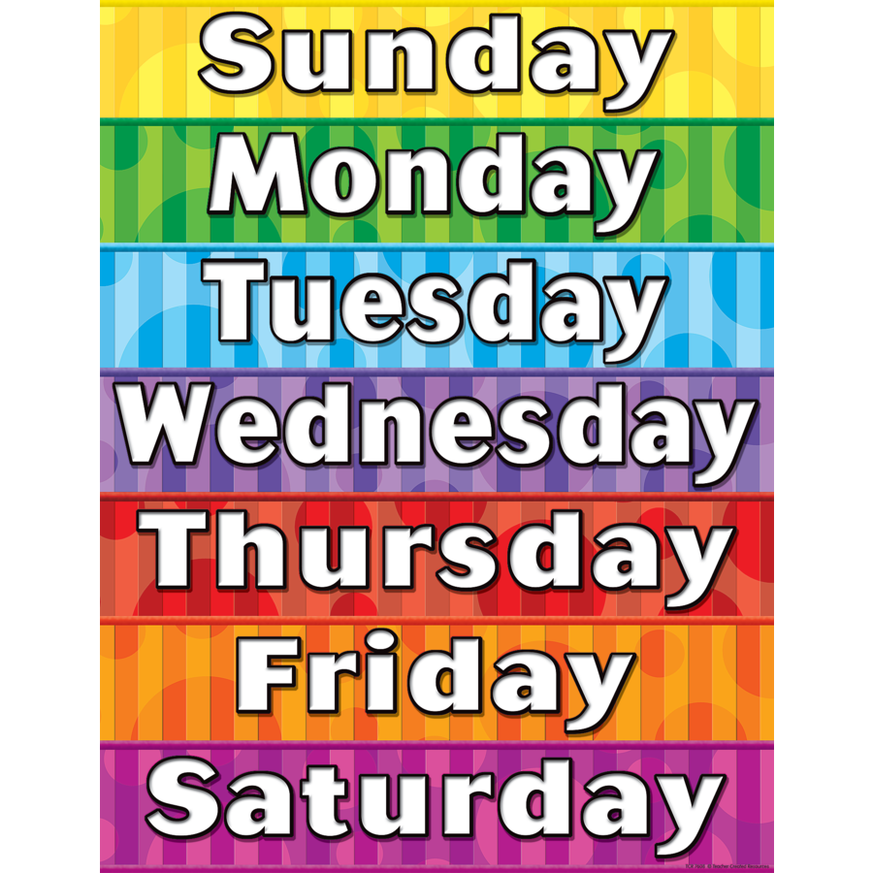
Yesterday
Different Types of Days

Slide 4
https://www.youtube.com/watch?v=o2FiIEVQVPc

Slide 5
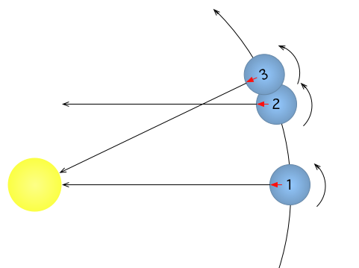
In your science journal
Solar Day
Sidereal Day
Definition
Length (time)
Sketch
Definition
Length (time)
Sketch
Why is there a difference?

Slide 6
Two Different Years
Solar (Tropical Year)
Common year
Definition
Length (time)
Sketch
Definition
Length (time)
Sketch

Slide 7
Make this in your science journal
Solar (sidereal/ Tropical) year
Common year
Definition
Length (of time)
Sketch

Slide 8
The earth doesn’t rotate an even number of days in one trip around the Sun

Slide 9
https://www.youtube.com/watch?v=YTOr8_ILqGw

Slide 10
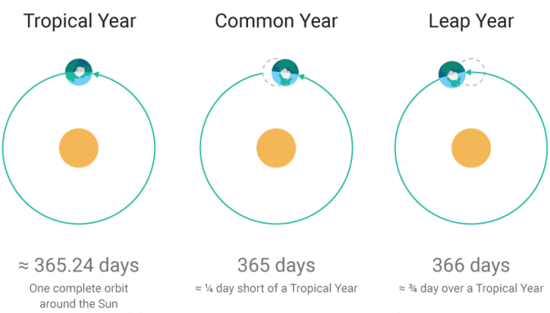
Make this in your science journal
Solar (Tropical/ sidereal) year
Common year
Definition
Length (of time)
Sketch
1 trip around the sun
365.24 days
What we use on our calendars
365 (or 366) rotations/days

Slide 11
So leap years…
Why?
To get things lined up again

Slide 12
https://www.youtube.com/watch?v=CXcN4K7LiB4

Slide 13
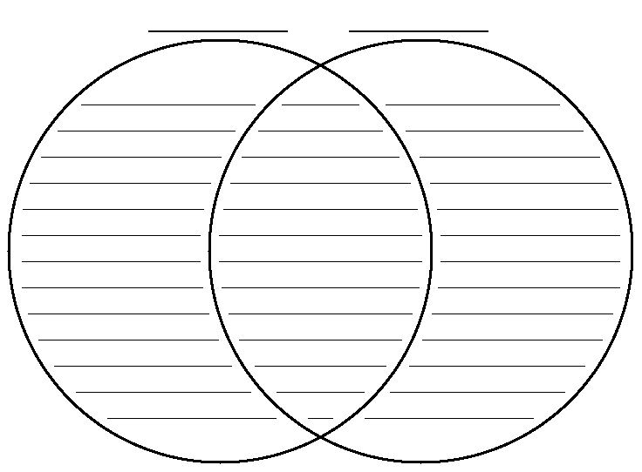
Compare and Contrast
Common year
Solar year
Why is there a difference?

Slide 14
Compare and Contrast
Common year
Solar year
365 days
Measured using earth’s rotation
What most people think of as a year
Both have to do with the earth orbiting
Neither is exact
We need to use both
365.24 days
Measured using earth’s revolution
The reason we need a leap year
Why is there a difference?
Because the earth doesn’t spin a whole number of times in one 1 360 degree revolution of the Sun

Slide 15
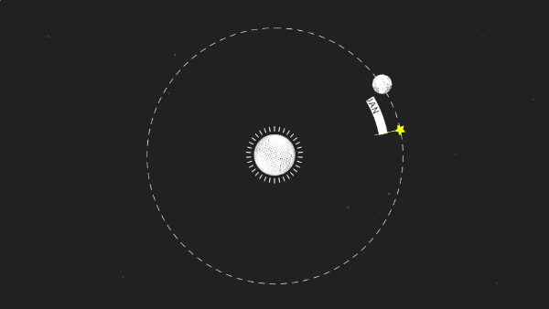
Exit Ticket
What would be the result if we didn’t add in an extra day every 4 years?

