Slide 1
Learning Goals:
4. Complex Knowledge: demonstrations of learning that go aboveand above and beyond what was explicitly taught. 3. Knowledge: meeting the learning goals and expectations. 2. Foundational knowledge: simpler procedures, isolated details, vocabulary. 1. Limited knowledge: know very little details but working toward a higher level.
I will:
understand the properties of different types of galaxies.
understand how the universe came to be what we observe today.
understand how astronomers use astronomical objects (standard candles)
Understand how we use a distance ladder to estimate the size of the universe and to measure large distances in the universe.
understand how astronomers determine the age and size of the universe?.

Slide 2
Welcome to college (University of Washington)
This is a college lab
If you are going to college next year, this is the caliber of work that will be expected of you
If you aren’t, you’ll get a taste of what you are missing out on!
This will take the next four days (plus the weekend)! Today, Wednesday, Thursday, and Friday.
You will have a part of it due each day. The final response questions are due Monday. If you aren’t working each day, you wont finish!

Slide 3
When are things due.
Tuesday – Step 1 and Step 2
Wednesday – Step 3
Thursday – Step 4
Friday – Step 5
Sunday at Midnight – Step 6

Slide 4
READ THE INSTRUCTIONS!!!!! I cannot stress this enough!

Slide 5
Today:
We are doing:
“Step 1: Getting to Know the Galaxies,” and
“Step 2: Selecting Your Galaxies.”

Slide 6
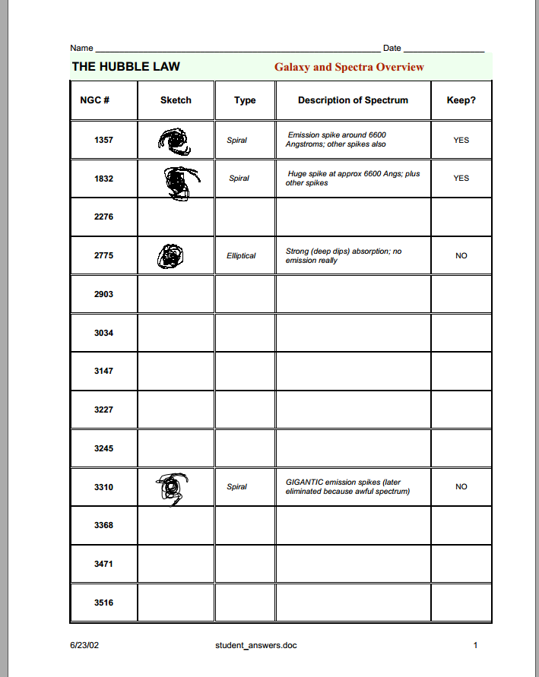
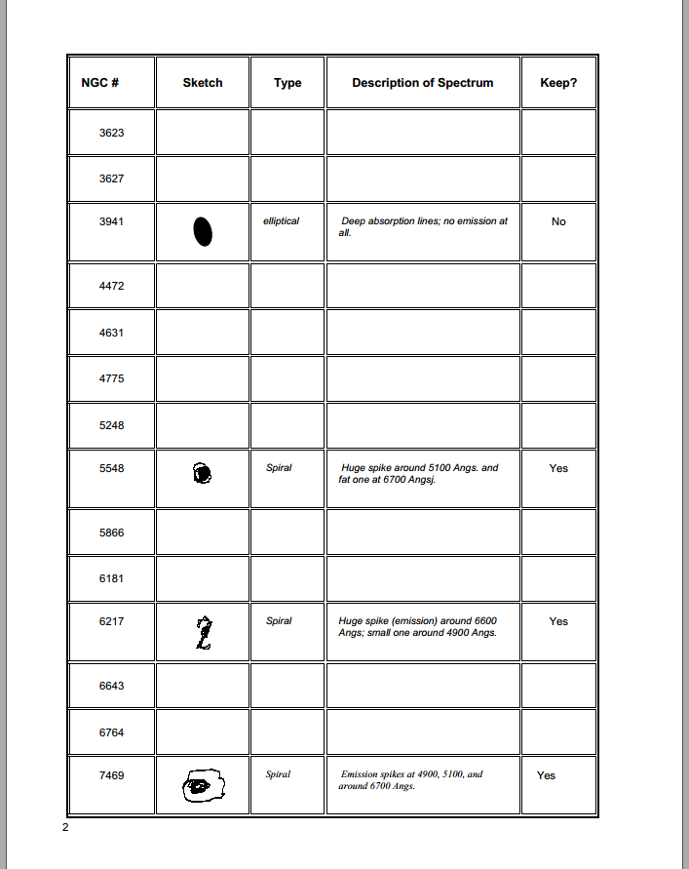
These should be done today!

Slide 7
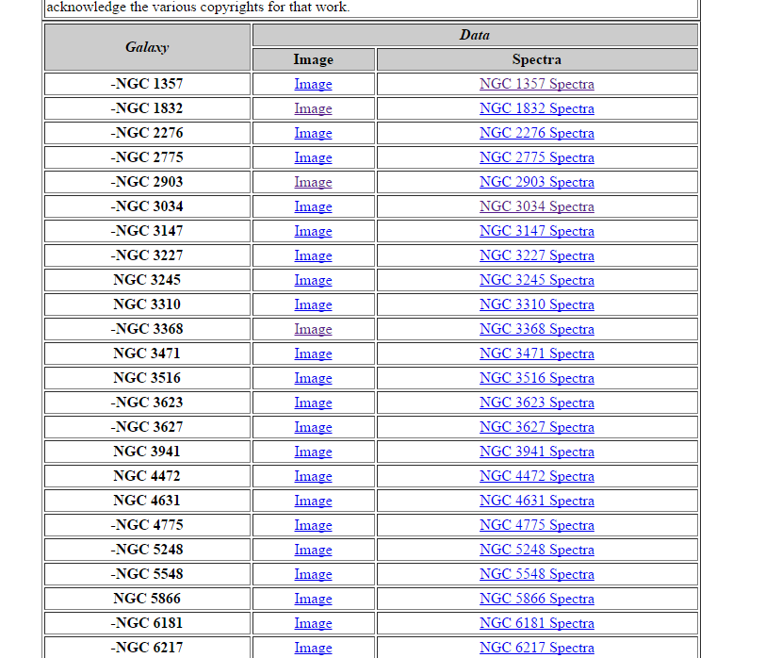

Slide 8
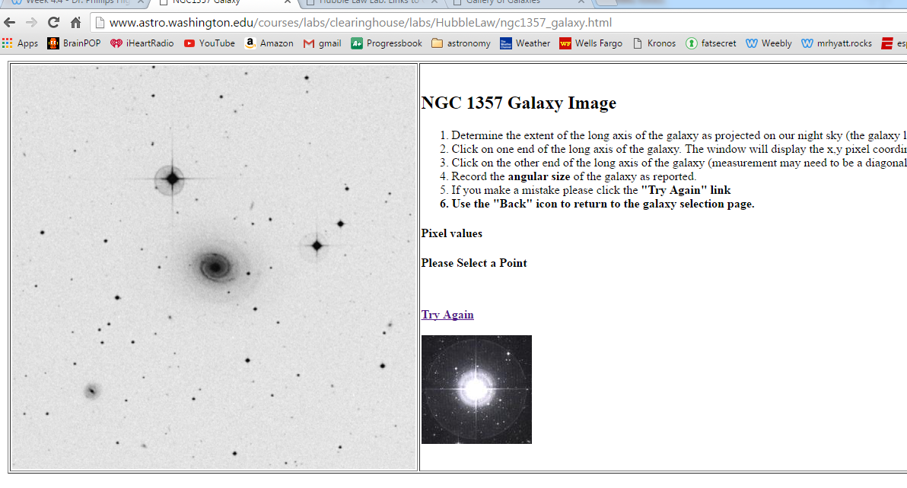

Slide 10
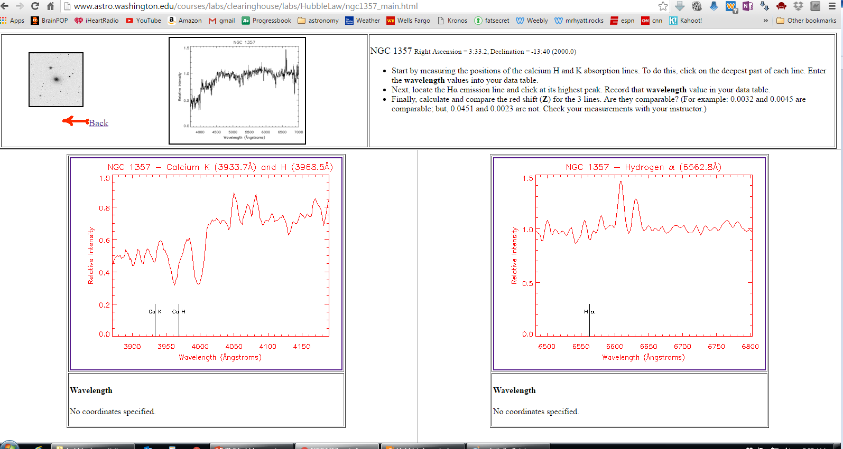
Emission lines
Absorption lines

Slide 11
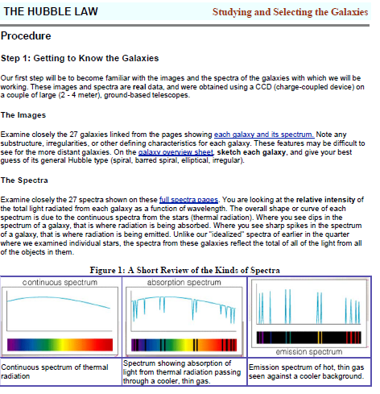
Go to the Step 1 Instructions and start reading

