Slide 2
Learning Goals:
I will:
understand the properties of different types of galaxies.
understand how the universe came to be what we observe today.
understand how astronomers use astronomical objects (standard candles)
as a distance ladder to estimate the size of the universe and to measure large
distances in the universe.
understand how astronomers determine the age and size of the universe?.
4. Complex Knowledge: demonstrations of learning that go aboveand above and beyond what was explicitly taught. 3. Knowledge: meeting the learning goals and expectations. 2. Foundational knowledge: simpler procedures, isolated details, vocabulary. 1. Limited knowledge: know very little details but working toward a higher level.

Slide 3
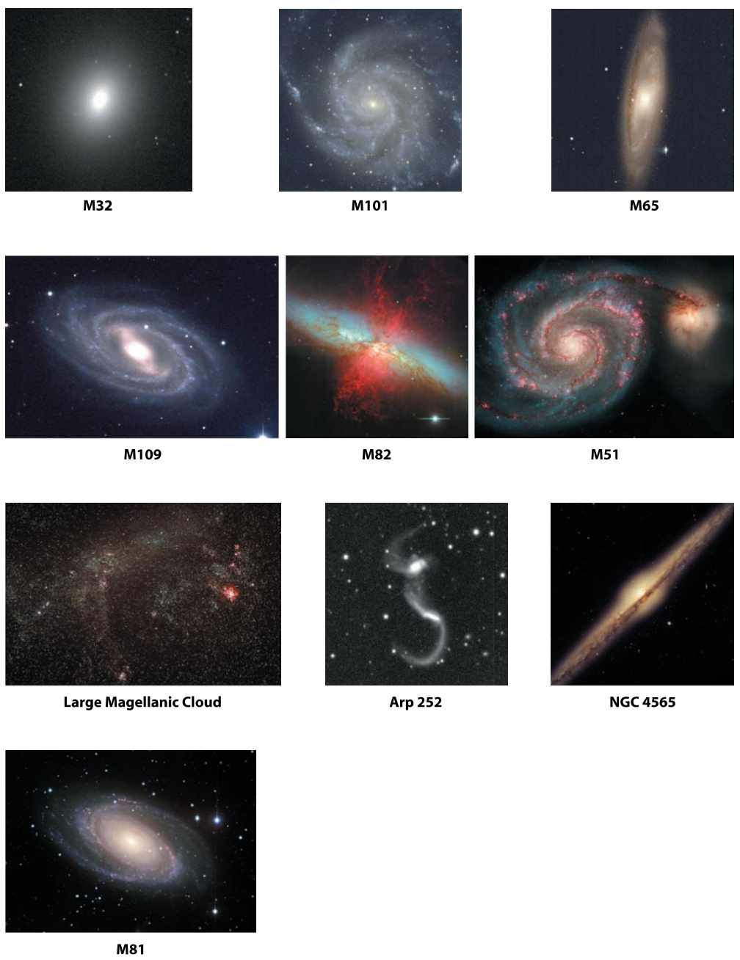
Sorting Activity
Please make sure these end up back into their baggies!

Slide 4
Create something similar in your journal
YOU decide what the classification schemes are
You decide how many groups each one needs

Slide 6
Create something similar in your journal
YOU decide what the classification schemes are
You decide how many groups each one needs

Slide 7
How would we classify vehicles?

Slide 8
LOCOMOTION

Slide 9
SIZE

Slide 10
Sorting Activity
Please make sure these end up back into their baggies!

Slide 11
What types of things did you use to categorize?
Shape
Size?
Color?
Density of stars?
Luminosity?
Distance?
Constituents? (types of stars)
Central Bulge?
Motion? (could astronomers use this?)
There is no real correct way to organize them.

Slide 12
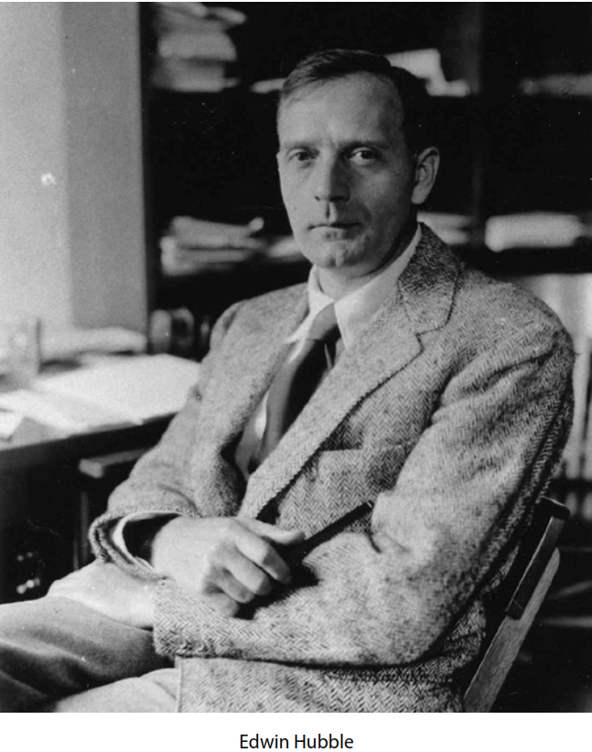
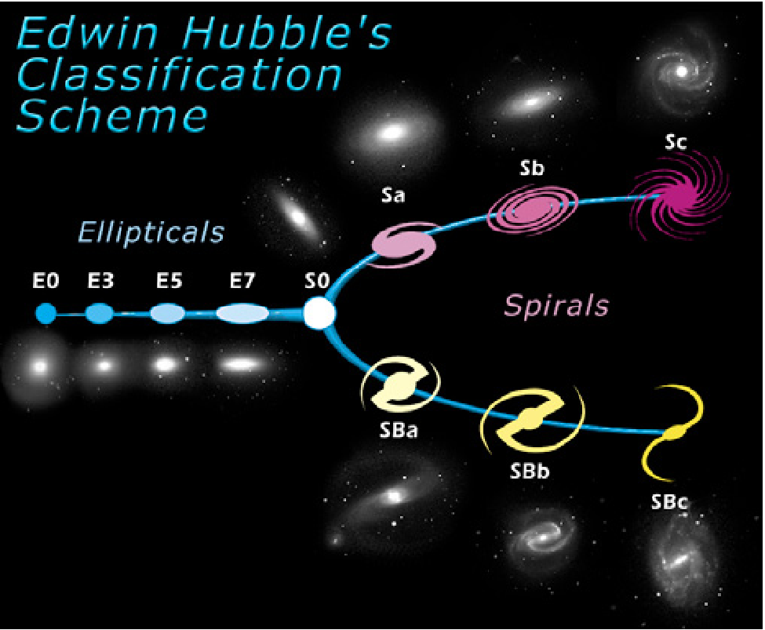
Edwin Hubble
1920’s looked at thousands of galaxies and organized them based only on their shape
He did A LOT of other things too!
That’s why he has a space telescope named after him
His tuning fork example seemed to show an evolutionary trend from young to old.
Start as an Elliptical
Ends as a spiral
Now we know that isn’t necessarily correct, but we still use his system, though with some changes

Slide 14
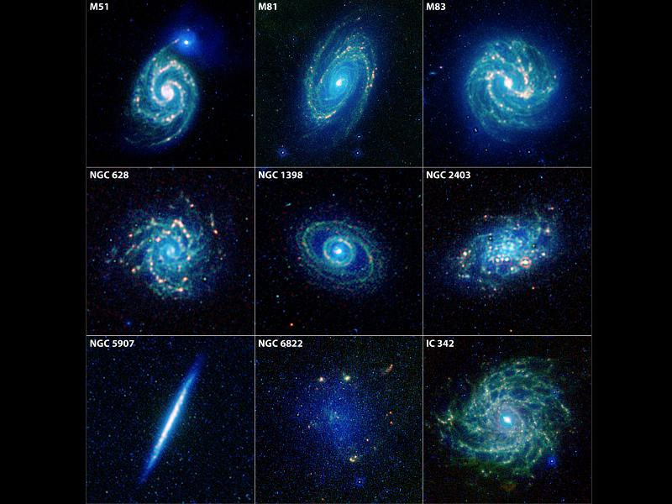
Galaxies - Now
Type 1: spiral
Type 2: elliptical
Type 3: irregular

Slide 15
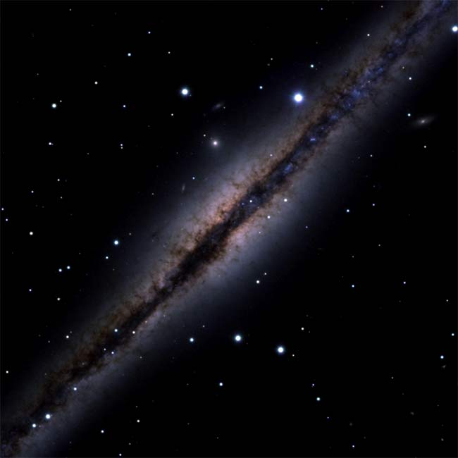
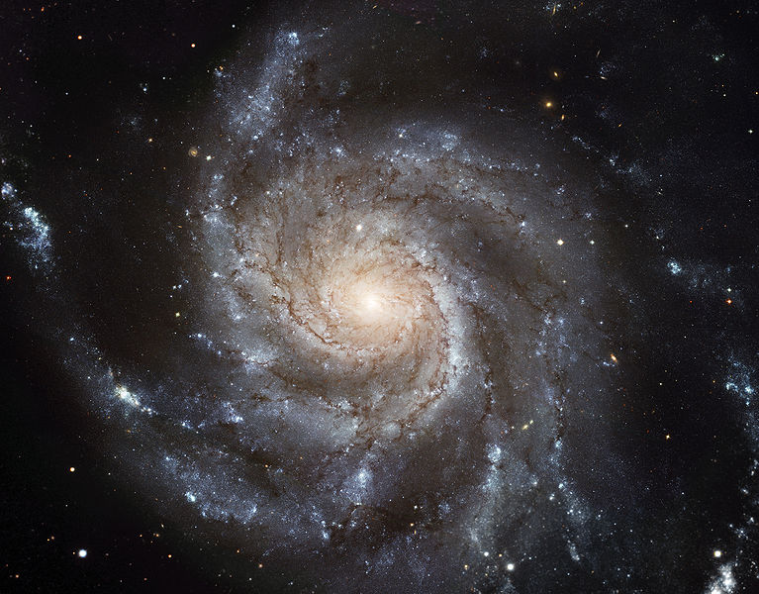
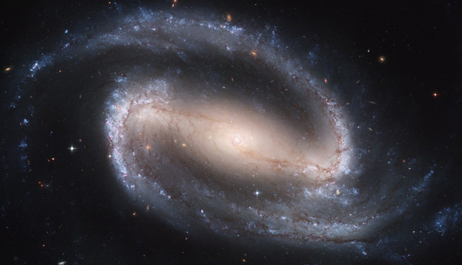
Type 1: spiral
Flattened disk of gas dust and stars with bright central bulges and spiral arms
M101 – pinwheel
2/3 have central bars
Barred Spiral NGC 1300
NGC 891

Slide 22
https://www.youtube.com/watch?v=GvzggE56UdY

Slide 23
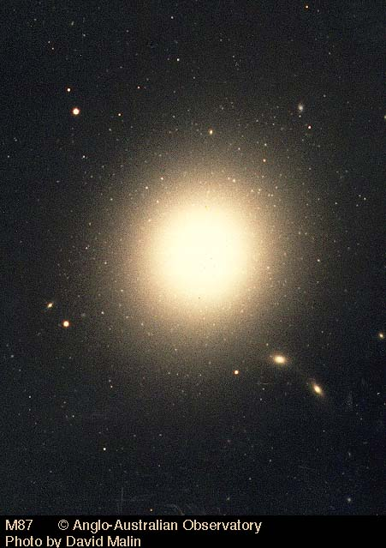
Type 2: elliptical
Football or sphere shaped, little gas and dust, not much ongoing star formation
Used up all their star forming material already.
Are these older or younger than spiral galaxies?
M87 – Virgo A

Slide 25
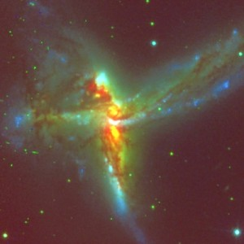
Type 3: irregular
Neither spiral or elliptical, more common far away from earth. Could be due to galactic collisions or gravity pulling apart other galaxies.
Bird Galaxy

Slide 26
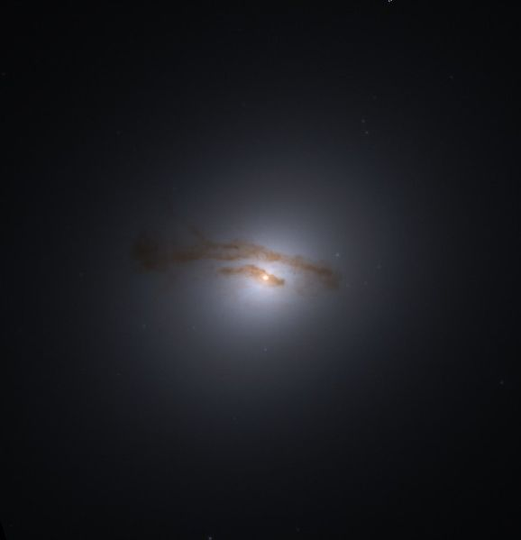
Galaxy 1 : M84
elliptical

Slide 27
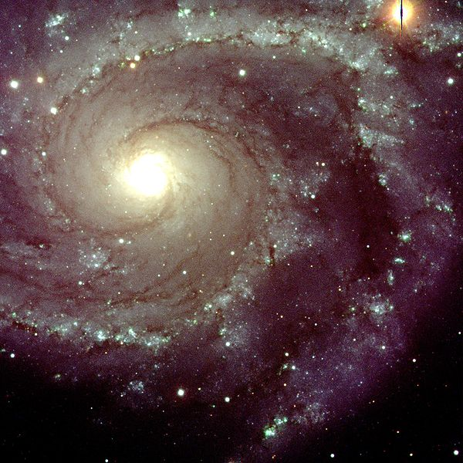
Galaxy 2: NGC 2997
spiral

Slide 28
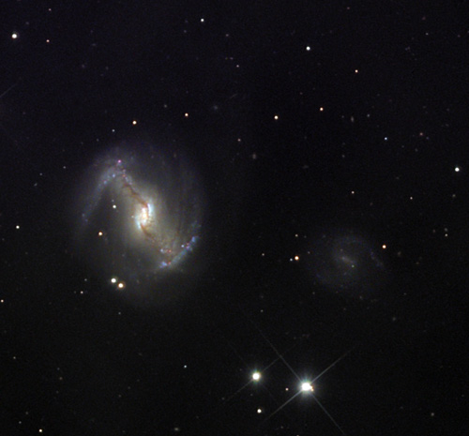
Galaxy 3: NGC 5383
Barred Spiral

Slide 29
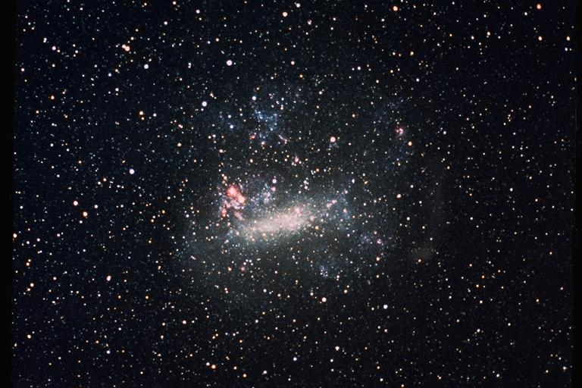
Galaxy 4: Large Magellanic Cloud
irregular

Slide 30
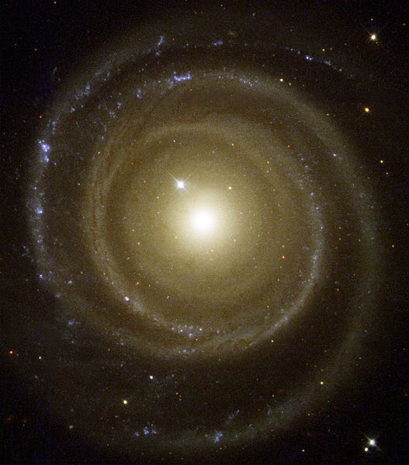
Galaxy 5: NGC 4622
spiral

Slide 31
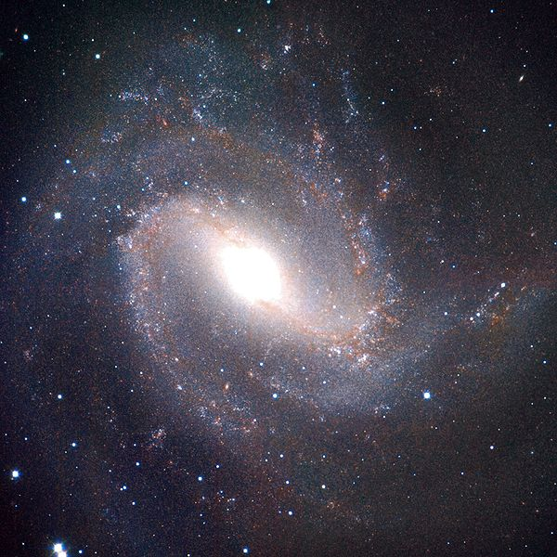
Galaxy 6: M83
Barred spiral

Slide 32
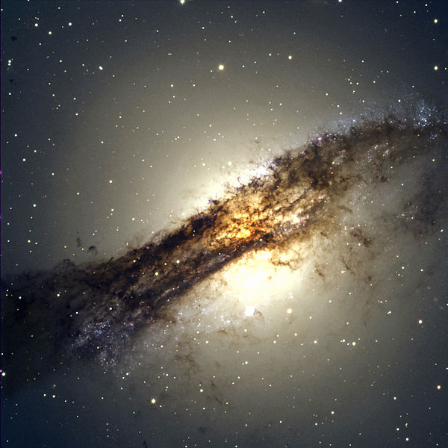
Galaxy 7: Centaurus A
irregular

Slide 33
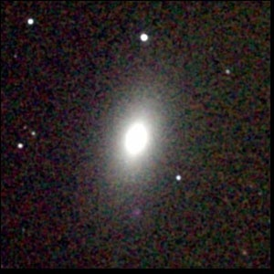
Galaxy 8: M59
elliptical

Slide 34
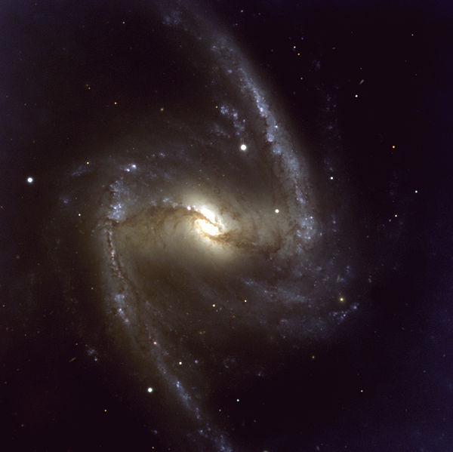
Galaxy 9: NGC1365
Barred Spiral

Slide 35
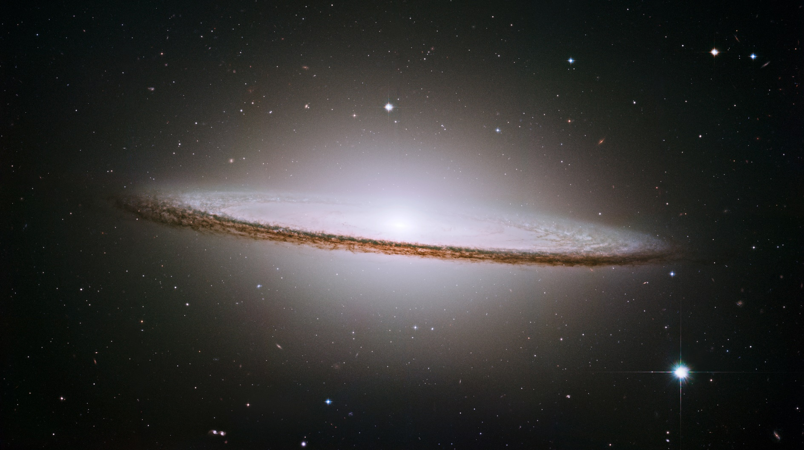
Galaxy 10: Sombrero
Spiral

Slide 36
If you were to re-do your classifications based on Hubble’s categories
Would anything change?
What?
Why would things change?\Why would they stay the same?

Slide 37
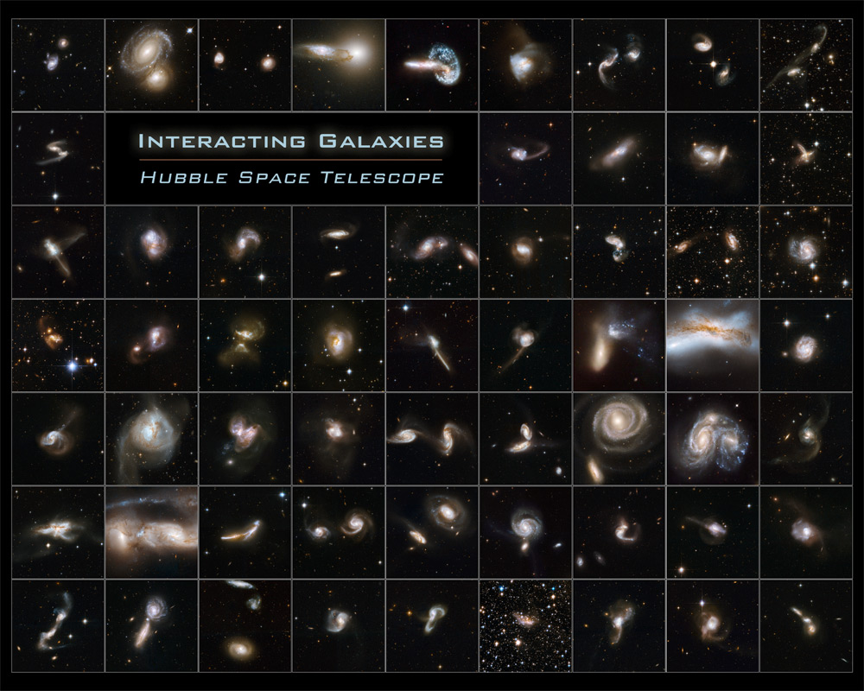
https://www.zooniverse.org/projects/zookeeper/galaxy-zoo/
https://www.galaxyzoo.org/

Slide 38
Google Classroom Canvas

