Slide 1
Understand the electromagnetic spectrum and how it is organized.
Understand what different types of electromagnetic radiation can reveal about astronomical objects.
Understand and describe important properties of electromagnetic radiation.
Understand how technology is used to collect electromagnetic radiation and turn it into images.
Understand what can be learned from analyzing the light from astronomical objects.
Understand how different types of lenses and telescopes work
Understand and describe the quantization of energy at the atomic level
Understand that all objects emit and absorb electromagnetic radiation and distinguish between objects that are blackbody radiators and those that are
Qualitatively describe the shift in frequency in sound or electromagnetic waves due to the relative motion of a source or a receiver

Slide 2
Spectrum Analysis Lab
Finishing up

Slide 3
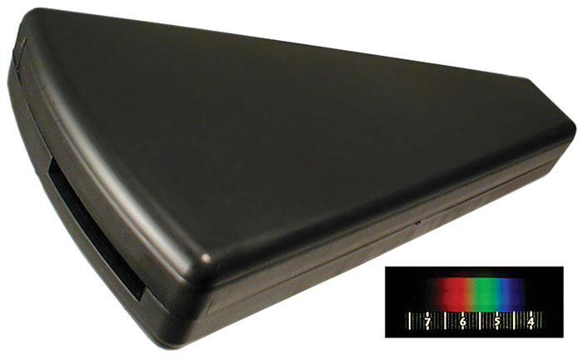
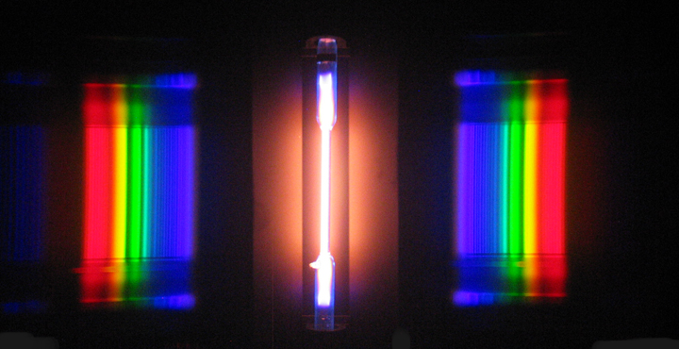
Keep track of the numbers at the bottom (wavelength in angstroms)
Refer to the screen at the front to figure out which element you are looking at
Please don’t take your markers with you when you change stations

Slide 4
At the end we will head outside
Don’t look at the sun!

Slide 5
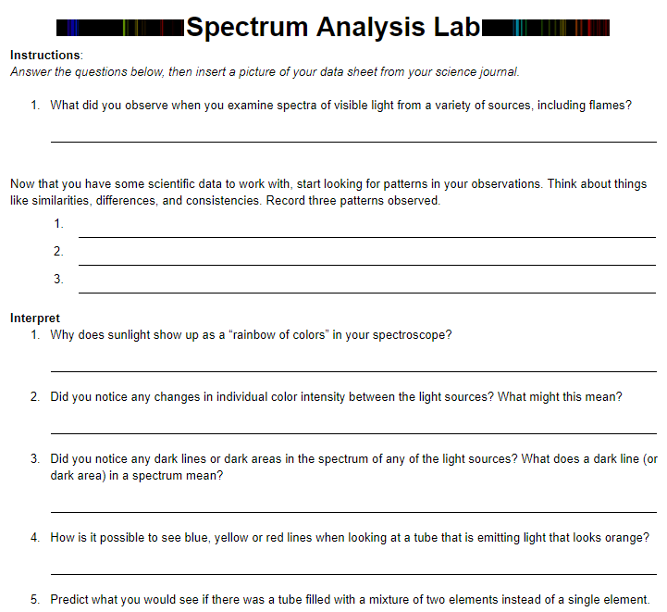
When you are done…
There is a lab write up on google classroom
Don’t forget to add a picture of your lab sheet at the end

Slide 6
I will ask you what element you think is in each tube
What do you think is in the one at the Mercury station
At the Venus Station
At the Mars Station
Etc….

Slide 7
Ar
H
He
Hg
I
Kr
Ne

Slide 8
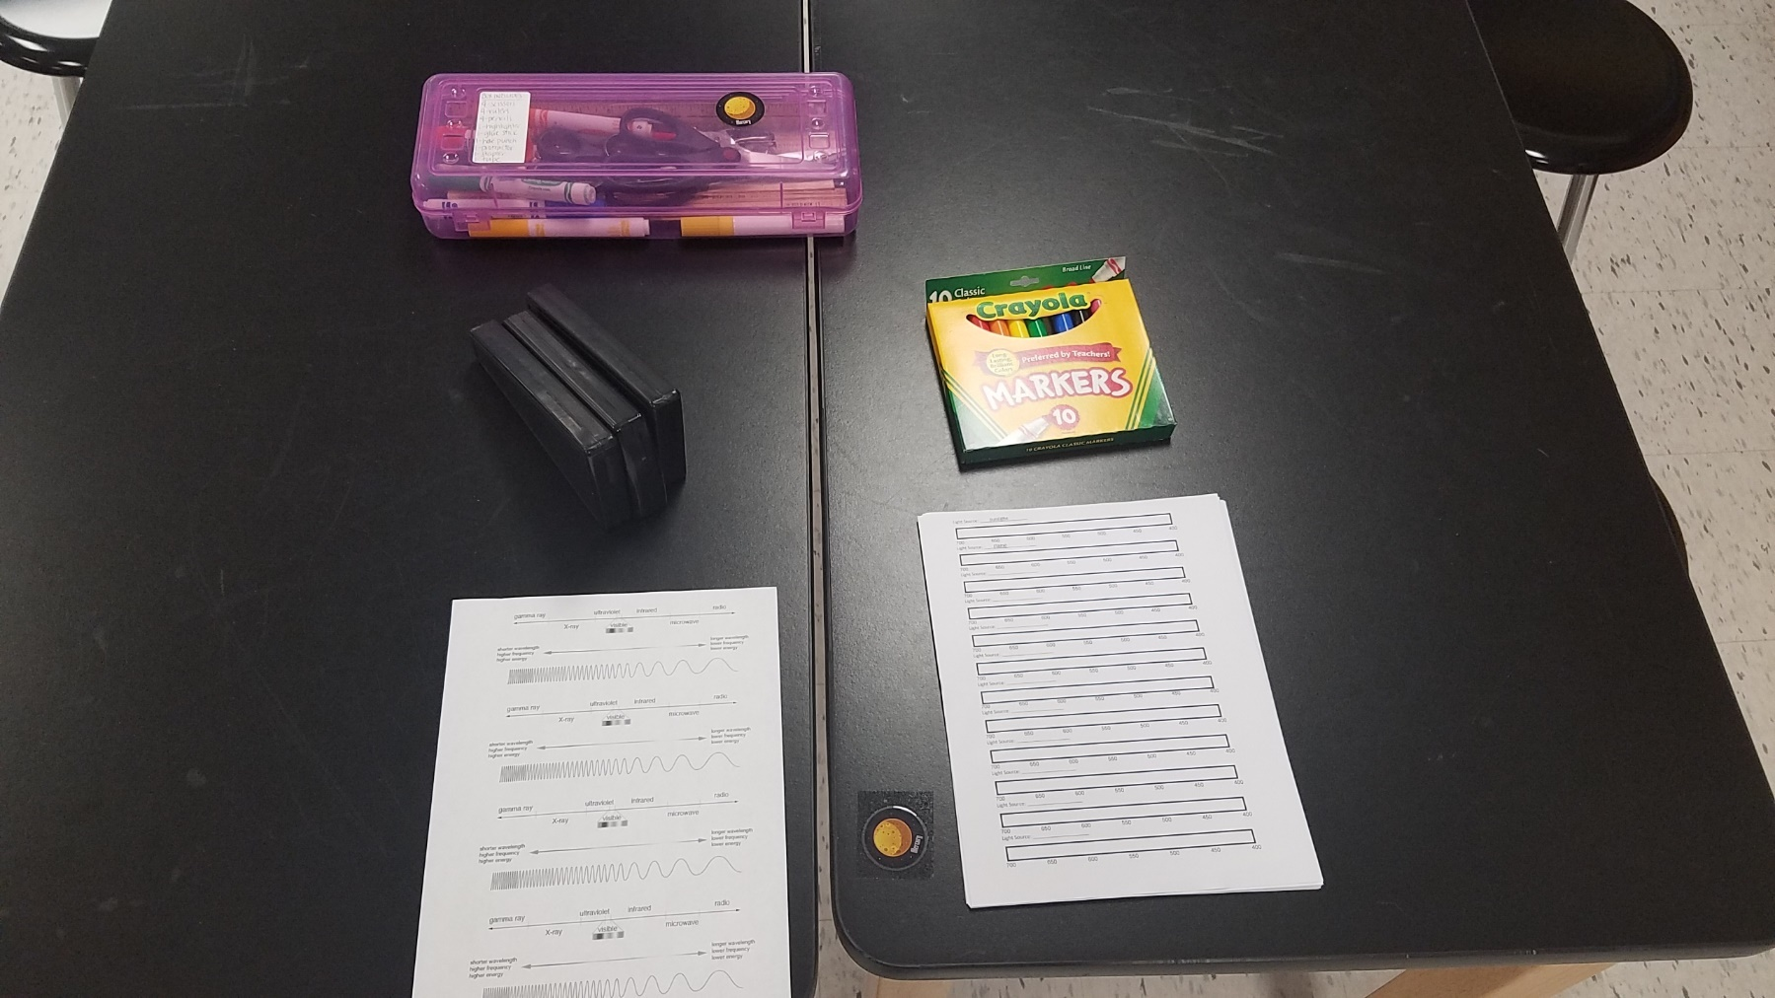
At the end of the class, your table should look like this!

