Slide 1
Complex Knowledge: demonstrations of learning that go aboveand above and beyond what was explicitly taught.
Knowledge: meeting the learning goals and expectations.
Foundational knowledge: simpler procedures, isolated details, vocabulary.
Limited knowledge: know very little details but working toward a higher level.
Understand how our view of the solar system has changed over time and how discoveries made have led to our changing our view of the solar system.
Learn planetary characteristics such as number of moons, size, composition, type of atmosphere, gravity, temperature and surface features.
Understand the movement of planetary bodies.
Understand which planetary characteristics are more important than others when it relates to our understanding of other worlds.
Understand how proximity to the sun influences planets.
Understand the methods and tools scientists use to learn about other planets and moons in our solar system.
Understand the conditions needed for a habitable world and determine if there are habitable worlds in our solar system or outside the solar system.
Understand how we look for and study solar systems other than our own.

Slide 2
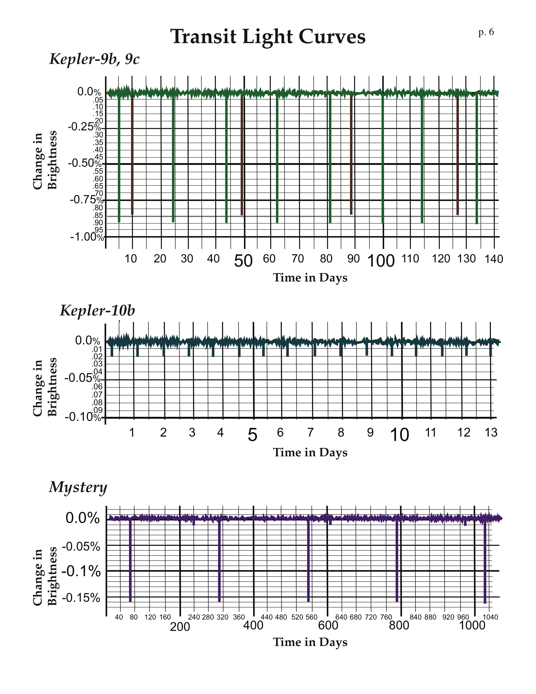
Notes:
Kepler 9: original discovery, announced in August, 2010.
Kepler 10: original discovery announced in January 2010: first rocky, Earth-size planet. Not a good place to live—very close to it’s star, and very hot.
Mystery Planet: there are two planets in this system, one shows the signature of a Earth-size planet on a one-year orbit—a habitable place to live. So far, Kepler has not observed just such a planet, although it has identified about 50 planet candidates (to be confirmed) in the habitable zone of their stars. (As of April, 2011).

Slide 3
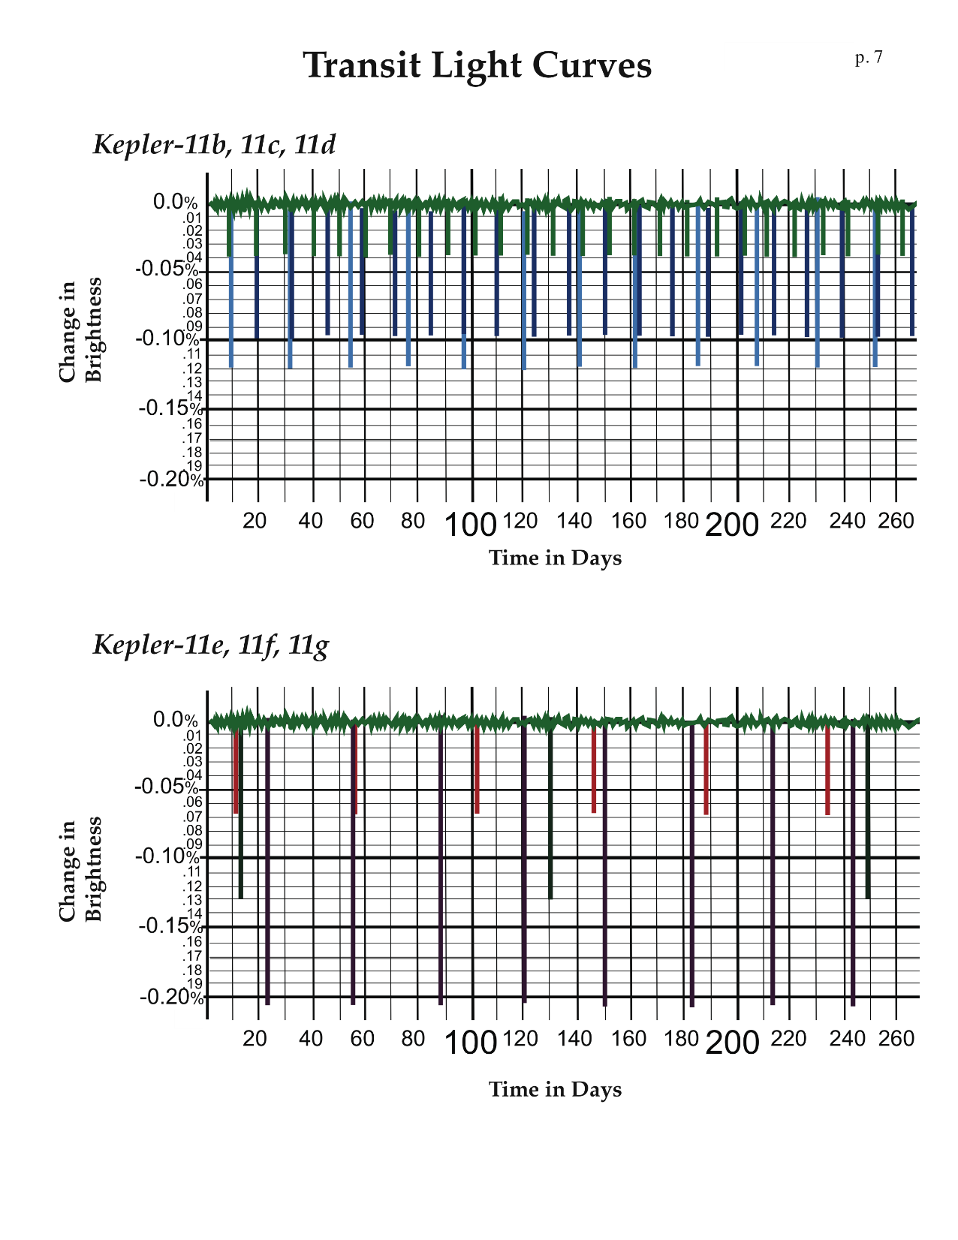
Notes:
Kepler-11 system has 6 known planets (February 2011). All transit, and all are closer to their star than the planet Mercury is to the Sun. Thus, they have very short-period orbits. The transit light curves are divided into two sets to make is simpler to analyze. The next slide (#33) shows the light curves, color coded, for all six planets together.

Slide 4
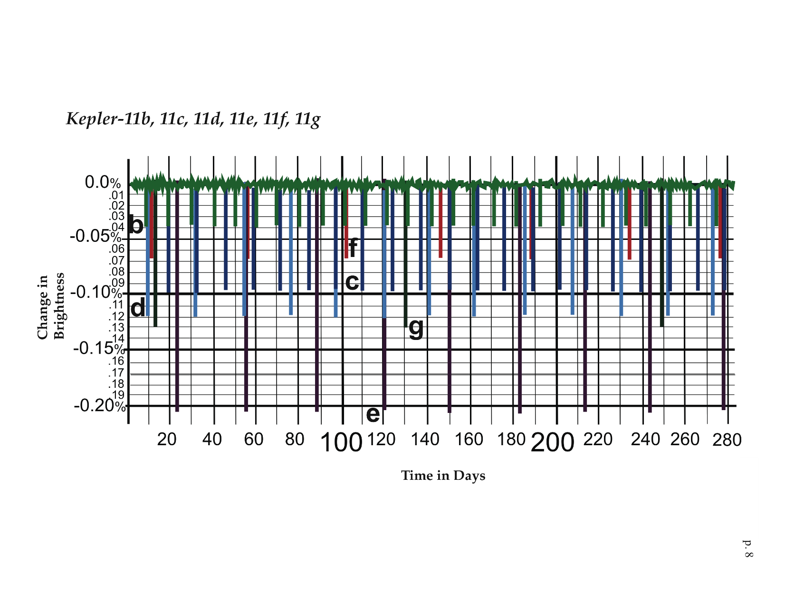
Notes:
Kepler 11: original discovery of a system with 6 planets, Announced February 2011.

Slide 5
Notes:
Note: The radius may be different than those that your students derive from the data in the exercise which was simplified for classroom use. This shows the actual light curves, orbital periods, and size of the first 5 planets discovered by Kepler Mission, announced January 2010. The size is expressed in terms of “Earth radii.” Kepler 4b is 4.31 time the radius of Earth, and is the smallest planet of this group. For comparison, Jupiter is more than 11 times the radius of Earth. Thus, all the other planets shown are larger than Jupiter.

Slide 6
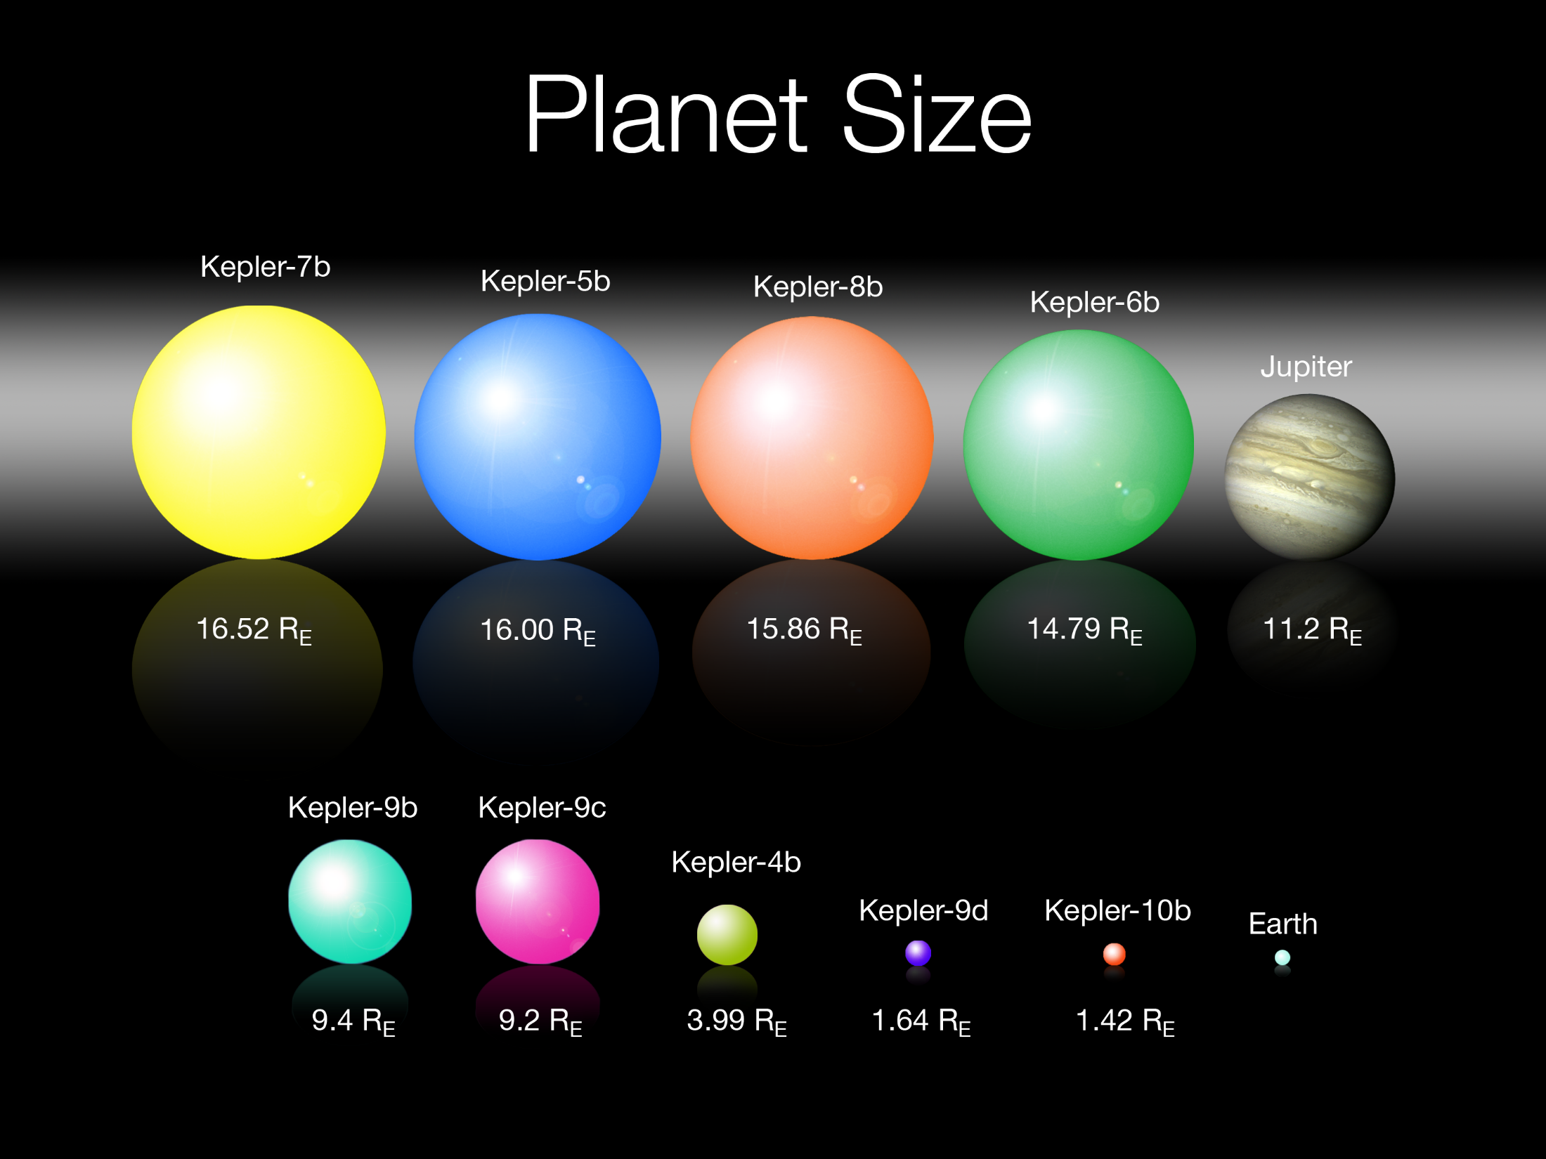
Notes:
These are some of the Kepler planets used in this lesson, with their sizes relative to Earth shown. Your students’ answers should be within 10-15% of these sizes.
No telescopes—in space or on the ground—are capable of taking photographs of these planets. So, they are simply represented by colored spheres.

Slide 7
Two common types of astrophysical phenomena that can masquerade as a planetary transit are grazing eclipsing binaries (left), where a pair of stars orbit each other, and background eclipsing binaries (right), where a distant binary star system is aligned very close to the star of interest. These require significant amount of ground-based observations to eliminate using radial velocity techniques.

Slide 8
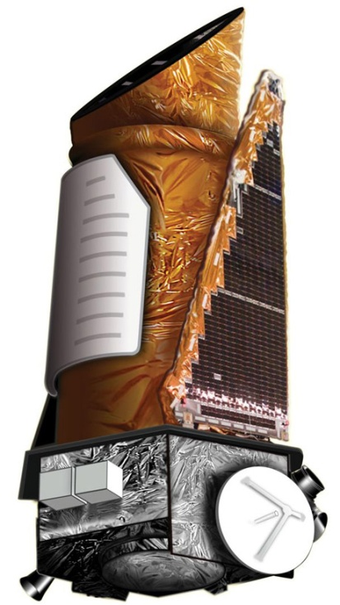
Who is looking?
NASA’s Kepler Telescope, currently orbiting the sun in an earth-trailing orbit. March 7, 2009. 550 million dollars

Slide 9
https://kepler.nasa.gov/images/videos/KeplerOrbitH264low2997fps.mov

Slide 10
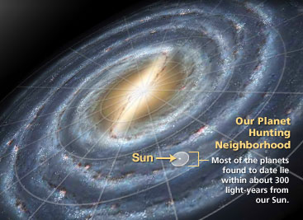
Where are we looking?

Slide 12
Kepler is looking at a very small fraction of the sky…
http://kepler.nasa.gov/images/videos/kepler_diagram_GalacticView_Web1_H264.mov
http://kepler.nasa.gov/images/videos/KeplerFOV_H264_Web.mov

Slide 13
Notes:
As of January, 2013, the Kepler Mission’s list of “planet candidates” is 2,740 orbiting 2,036 stars. These planet candidates await confirmation, although the majority are expected to be planets. Further information can be found at: http://kepler.nasa.gov/Mission/discoveries/candidates/

Slide 14
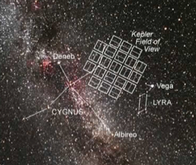
How Are the Discoveries Made?
Kepler detects planets by taking a photometric measurement of the stars in its field of view every 30 minutes. A planet transit will show as a small periodic dip in the “light curve” of a star over time.
If the host star’s diameter and temperature are known, then from the simple dip in the the light curve Kepler can determine the planet’s diameter and orbital period; the planet’s surface temperature can also be estimated.
Mission scientists require at least three transits—three orbits, or planetary “years”—to verify that a planet is present. This is what causes a planet to go from a “candidate” to “confirmed.”
How would this disqualify many planets in our own Solar System?
https://kepler.nasa.gov/images/videos/OccultationGraphWEB1_H264.mov
Notes:
Run your cursor over the upper image and click on the arrow to run the animation.
Note: Kepler can only detect the presence of planets whose orbits are oriented so that the planets pass across the face of their parent star from the spacecraft’s perspective.
Photometric—referring to photometry, the measurement of the intensity of light.
Light Curve—a graph of the brightness of a light source, like a star, over time.
The Kepler light curves reveal two key characteristics of the exoplanets: the diameter of the planet and the orbital period. The planet diameter is found from the percentage of light blocked; a 1% drop in brightness means the planet is 1% the diameter of the star. The orbital period is the time between transits: hours, days, weeks or months. Using the orbital period and Kepler's Third Law, the distance between the exoplanet and its star can be calculated, and the surface temperature estimated.
The size and temperature of Kepler's stars was determined by ground-based observations and refined by Kepler observations. Target star diameters are known to less than 10% from ground-based observing and stellar models; with asteroseismology done with Kepler photometery, the stellar diameter is refined to 1-2% accuracy. Thus the diameter of explanets are known to the same precision.
Asteroseismology is the study of the internal structure of pulsating stars by the interpretation of their frequency spectra.

Slide 15
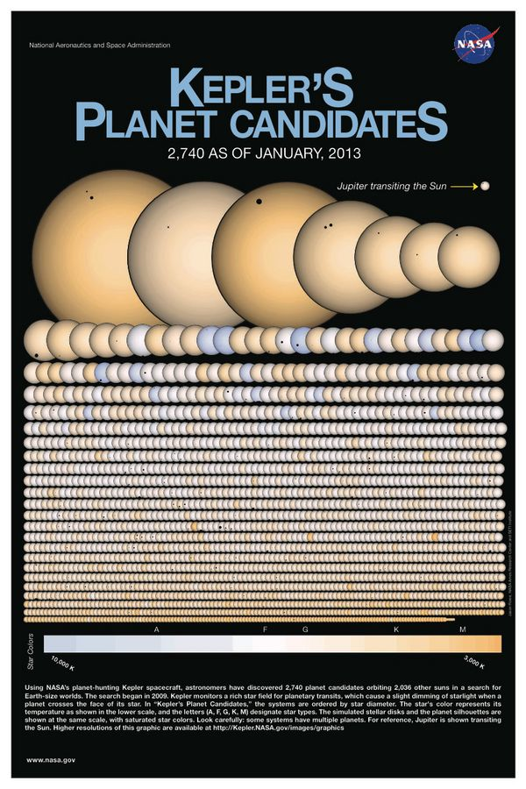

Slide 18
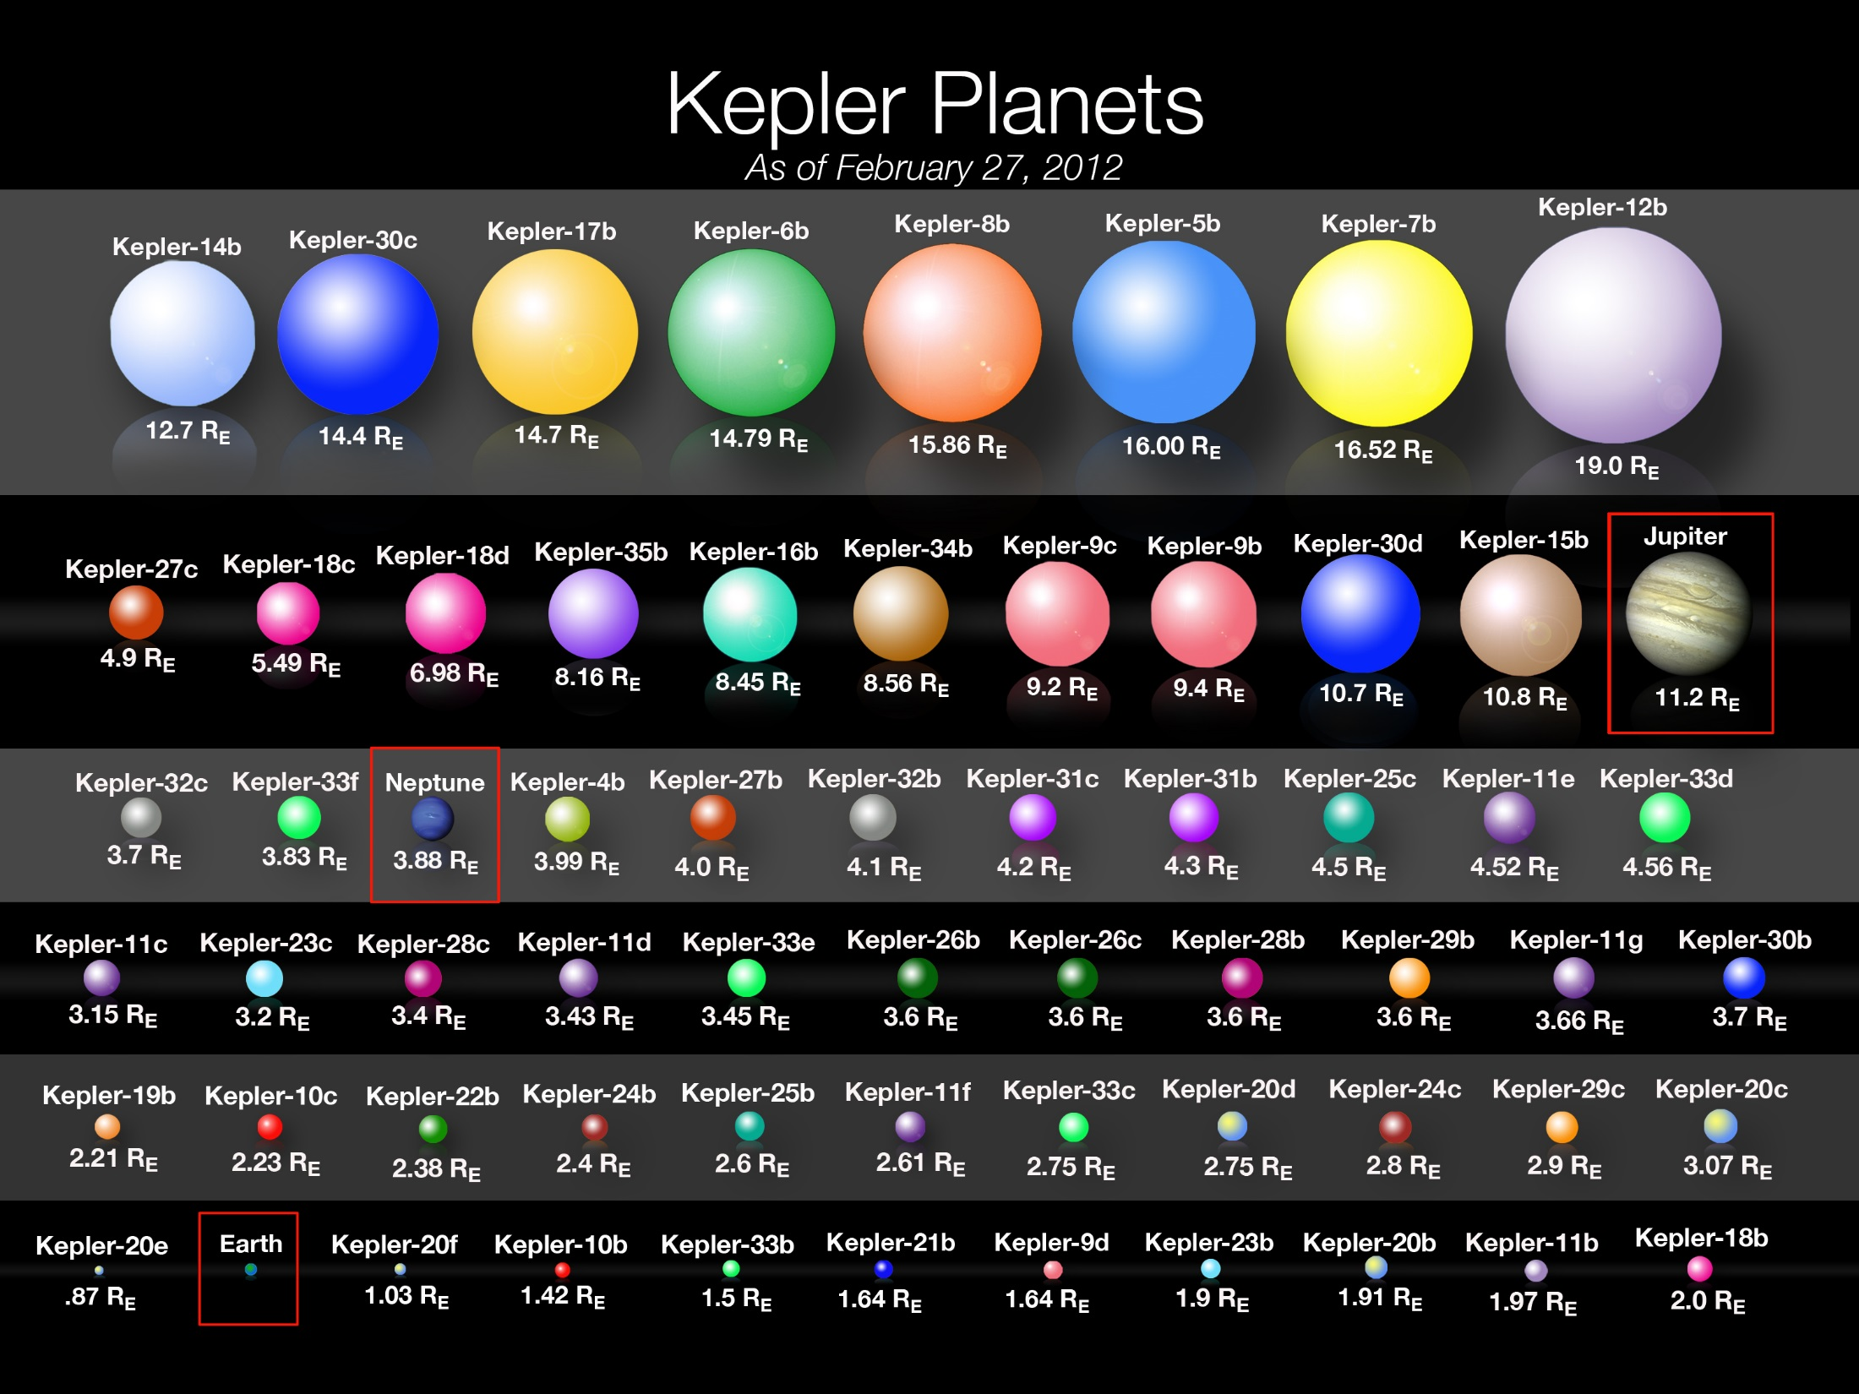
Notes:
Summary of planet sizes as of February 2012. These are confirmed planets, and their sizes are determined from the depth of the transit (% of light blocked) and the size of the star, which is determined from Earth-based observations or from Kepler data about the star. See slide 61 for derivation.

Slide 19
The colors simply go by order from the star (the most colorful is the 7-planet system KOI-351). The terrestrial planets of the Solar System are shown in gray
https://www.youtube.com/watch?v=gnZVvYm6KKM

Slide 20
All of the Kepler multi-planet systems (1705 planets in 685 systems as of 24 November 2015) on the same scale as the Solar System (the dashed lines). The size of the orbits are all to scale, but the size of the planets are not. For example, Jupiter is actually 11x larger than Earth, but that scale makes Earth-size planets almost invisible (or Jupiters annoyingly large). The orbits are all synchronized such that Kepler observed a planet transit every time it hits an angle of 0 degrees (the 3 o'clock position on a clock).
https://www.youtube.com/watch?v=_DnDeBa0KFc

Slide 21
Kepler and K2 ended last year

Slide 22
3/7/2009 – 10/30/2018

Slide 23
Who else?

Slide 24
Ground based

Slide 25
Space Based

Slide 26
Proposed/Planned

Slide 28
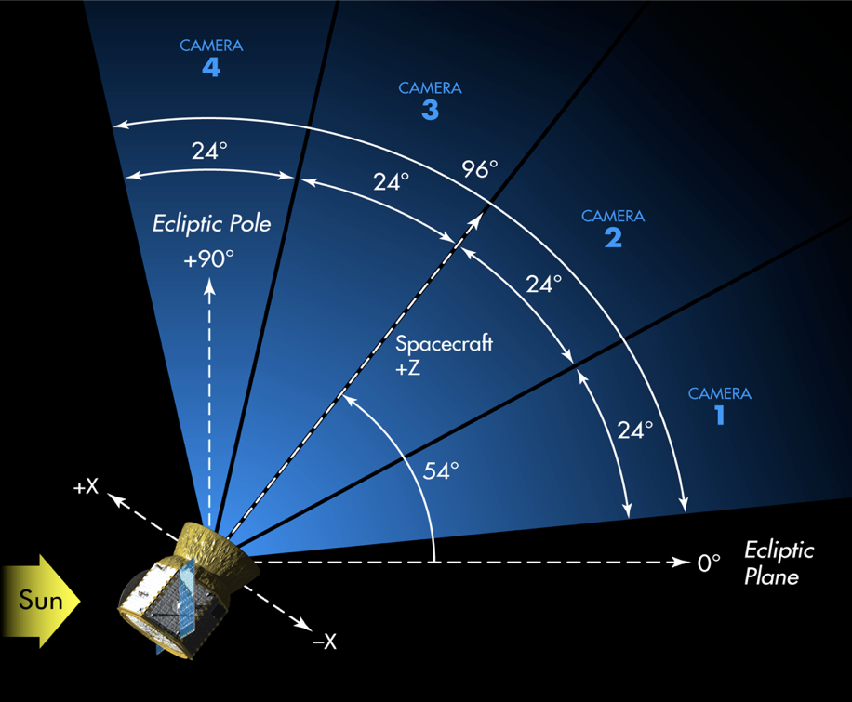
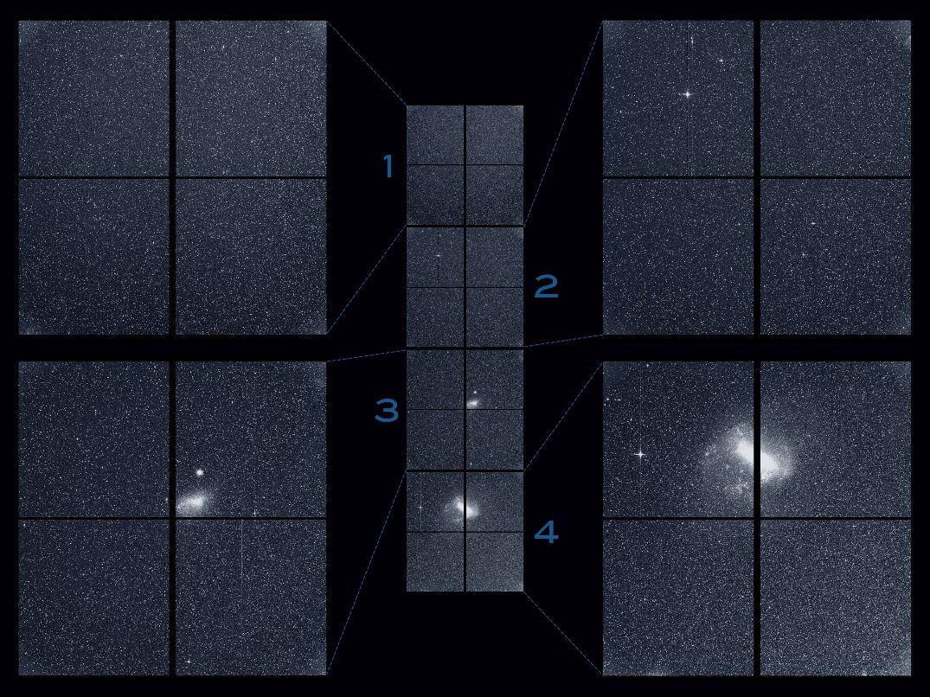
TESS – TRANSITING EXOPLANET SURVEY SATELLITE
More Cameras

Slide 29
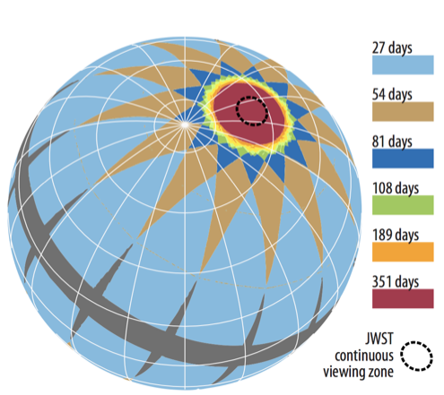
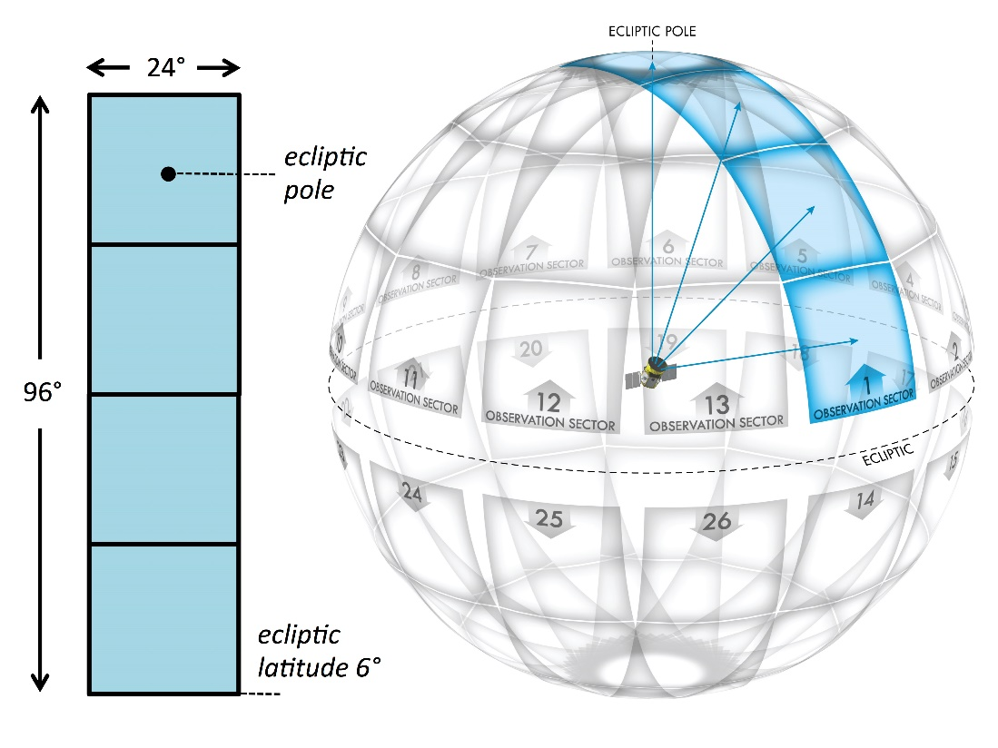
TESS – TRANSITING EXOPLANET SURVEY SATELLITE
Covers 85% of the sky

Slide 30
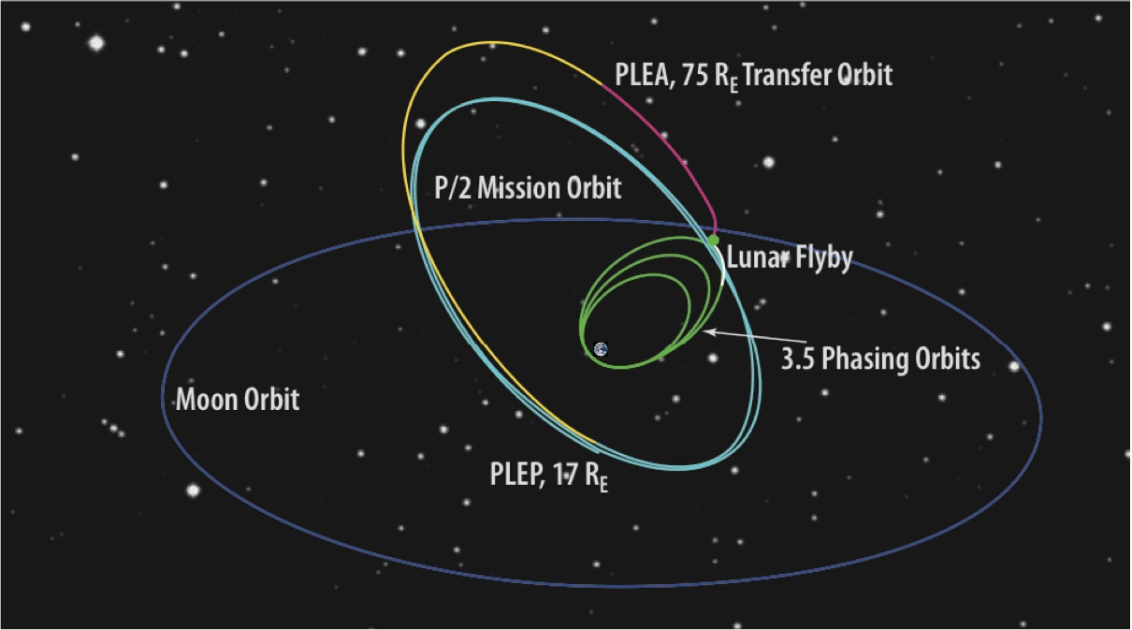
Overview
Only a 2 year main mission
Expected to find over 30,000 exoplanets
Kepler found just under 3,000
Orbits in a weird perpendicular orbit

Slide 31
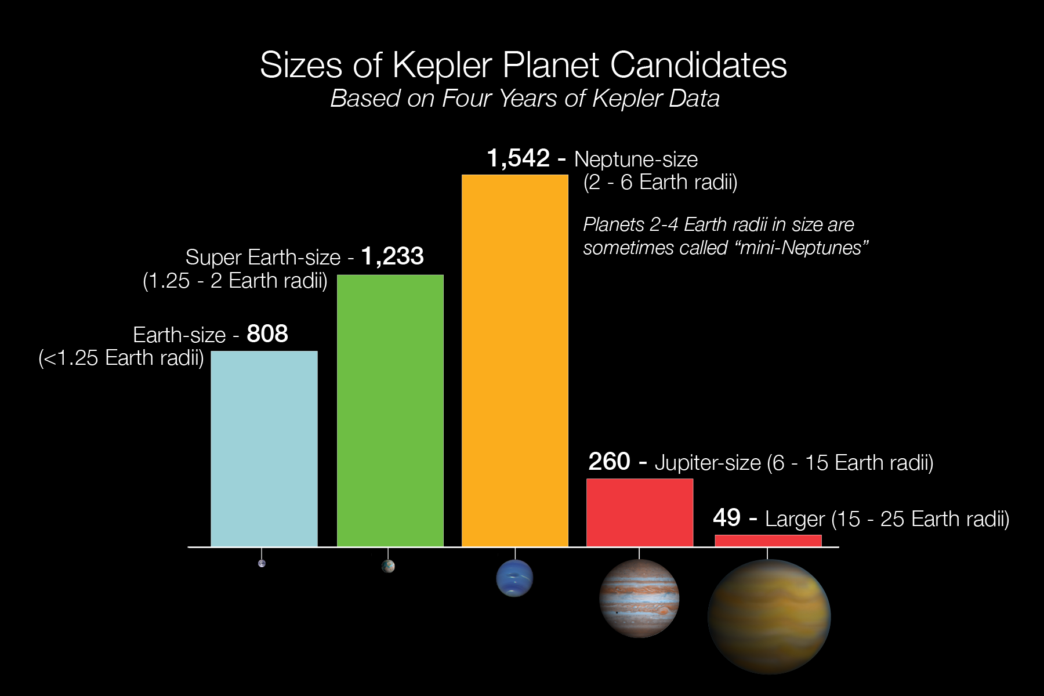
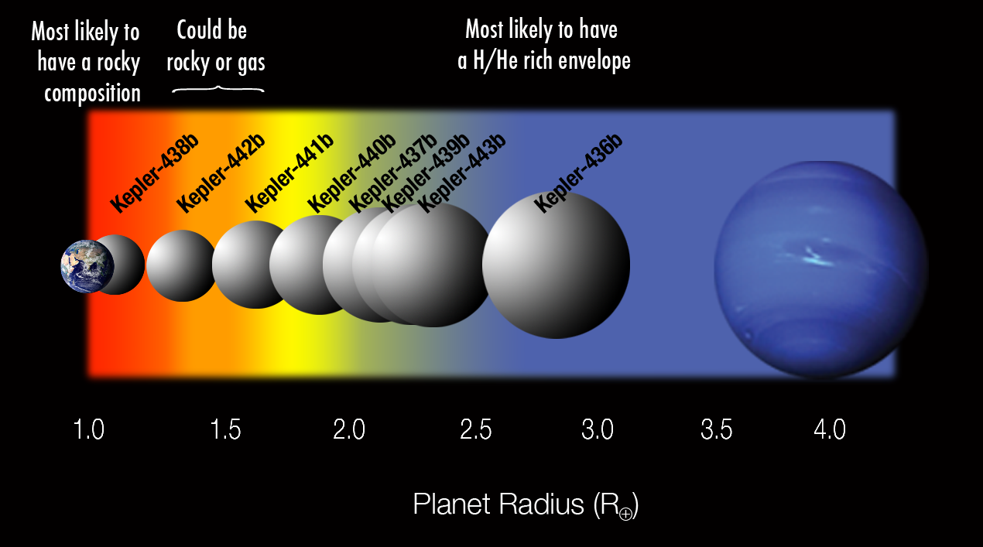
What are the Implications?
Kepler has shown that small planets are more plentiful than larger, Jupiter-size worlds, and are abundant in our galaxy.
Current models show that planets with a diameter smaller than roughly 1.5 times that of Earth are more likely to have rocky surfaces that could support liquid water and appropriate conditions to foster life as we know it. (paraphrase)
Earth-size planets are therefore key to discovering life beyond our solar system. As Kepler finds more exoplanets, that ultimate goal comes closer!
Credit: NASA Ames/Kepler Mission/W. Stenzel.

Slide 32
Another of Kepler’s Discoveries
https://www.youtube.com/watch?v=RlidbLyDnPs

Slide 34
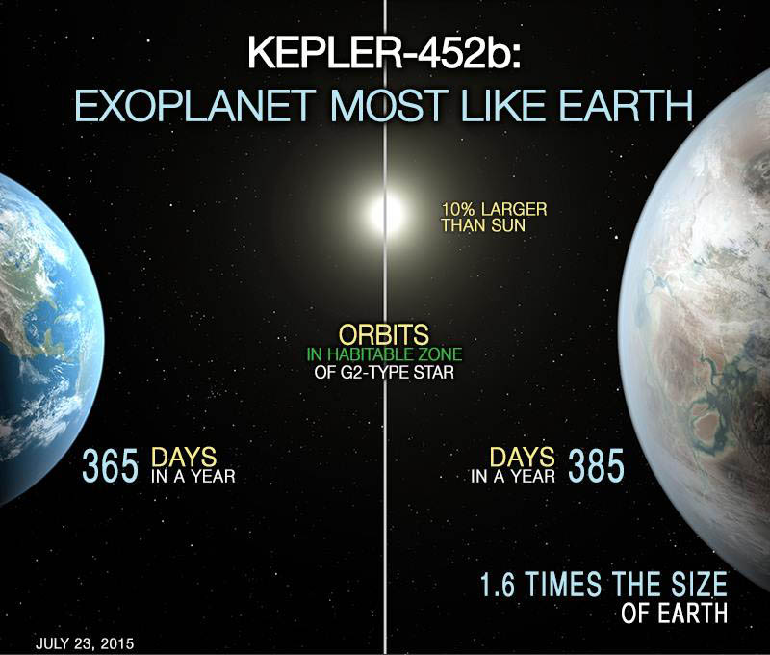
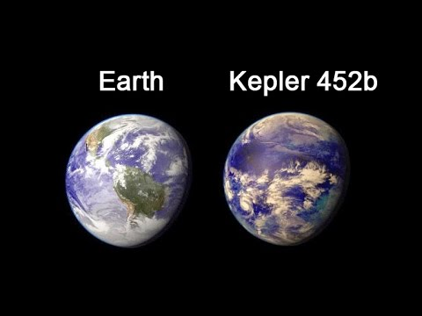
Earth’s Twin. Or is it cousin?!?
In July 2015, NASA announced the discovery of the closest “twin” to Earth yet discovered—in data collected by the Kepler spacecraft during its four-year mission.
The planet, designated Kepler-452b, is 1.6 times the diameter than Earth, orbiting every 385 days in the “habitable zone” of a star about the same size and temperature as the sun and just 20% brighter.
Artist’s conception of Kepler-452b. NASA Ames/JPL-Caltech/T. Pyle.
Notes:
The habitable zone of a star is the region around it in which an orbiting planet could experience temperatures suitable for liquid water to exist on the surface.

Slide 35
Proxima b
Orbits Proxima Centauri (a red dwarf) every 11 days --.05 AU’s away
4.25 ly away
About same size as Earth
It is rocky and inside the habitable zone of its planet
It would take about 80,000 years to get there

Slide 36
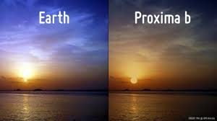
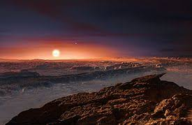

Slide 37
Trappist 1
40 ly away
7 planets in habitable zone
All are way inside mercury’s orbit

Slide 38
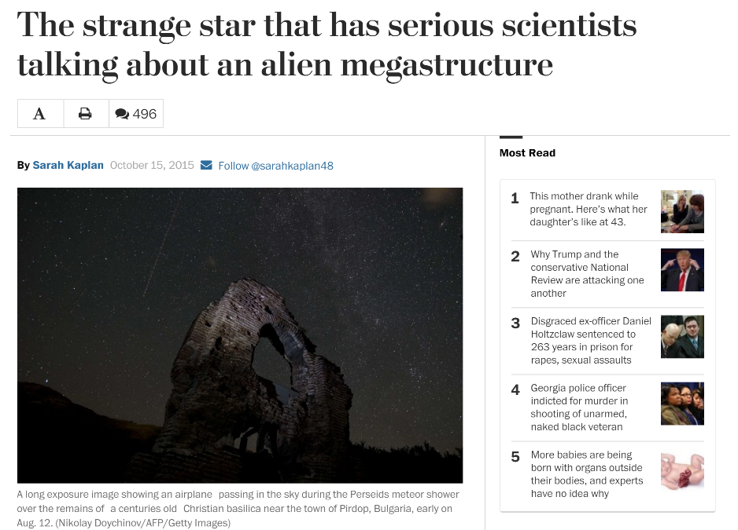
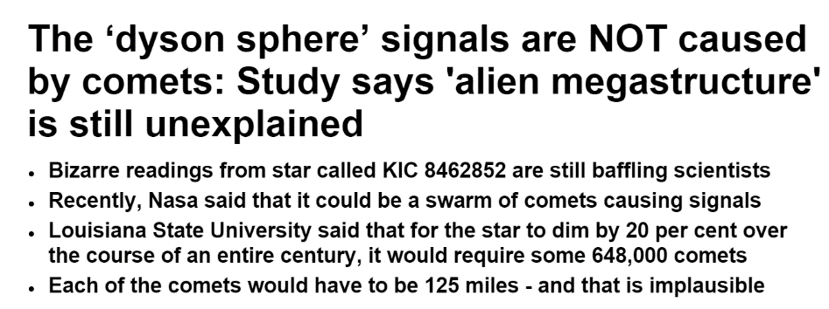
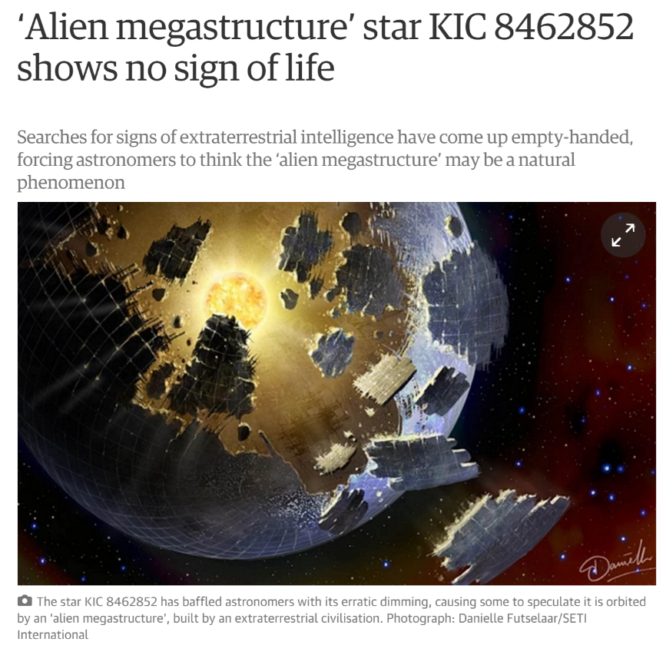
KIC 8462852
Tabby’s Star

Slide 39
1,480 ly away
Random Dips…
Unexplained Cooling

Slide 40
KIC 8462852 – Aliens? Probably not…
What the?!?!
When looking at old photographic plates of the sky, astronomers saw that over the past century, the star’s total light output has dropped by about 19 percent.
It also doesn’t emit any infrared light
This star isn’t just sputtering—it’s fading out entirely --Observationally, there is zero precedent for any main sequence star to vary in brightness like this
First spotted in the Kepler Space Telescope’s dataset in September (2015).
Main sequence F-type star—slightly hotter and larger than our sun.
Over four years of observational data, the star’s light output intermittently tanked, something that isn’t consistent with any astronomical phenomenon we’re aware of.

Slide 41
https://www.youtube.com/watch?v=8XDS_aTVBrE

Slide 42
Exit Ticket
Answer these two questions
Current Event and Transit Activity due at midnight

