Slide 1
You have Bellwork today
Welcome back!
If you turned in a poster for your project:
and you would like to keep it, you need to take it home today.
Because any that are left will be thrown away.

Slide 2
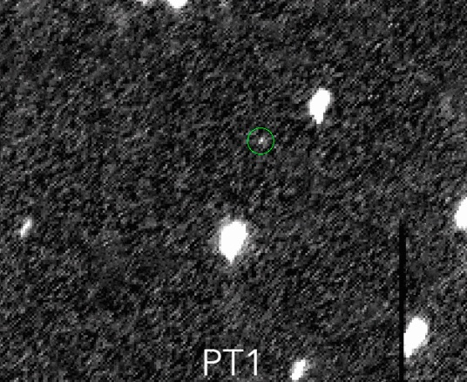
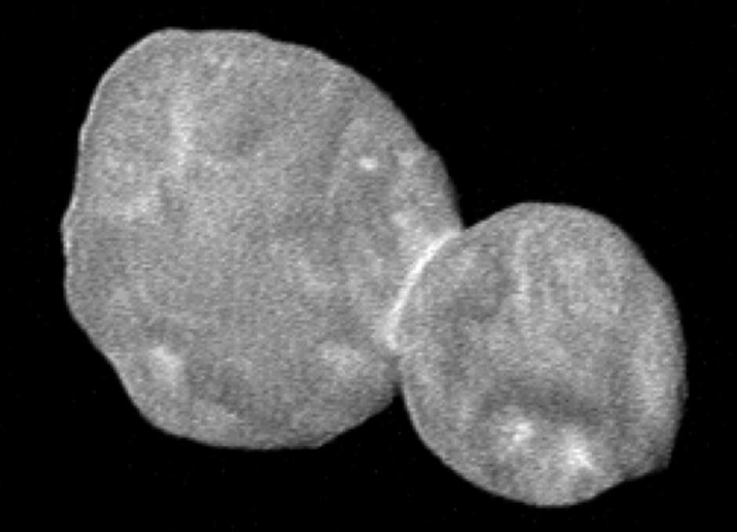
New Horizons Reached Ultima Thule

Slide 3
Today’s Docket
You have a Current Event on Canvas due Friday.
You have an EdPuzzle on Canvas due TODAY!

Slide 4
https://www.youtube.com/watch?v=zFPnOUSdMdc

