Slide 1
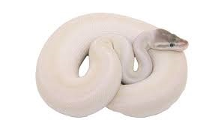
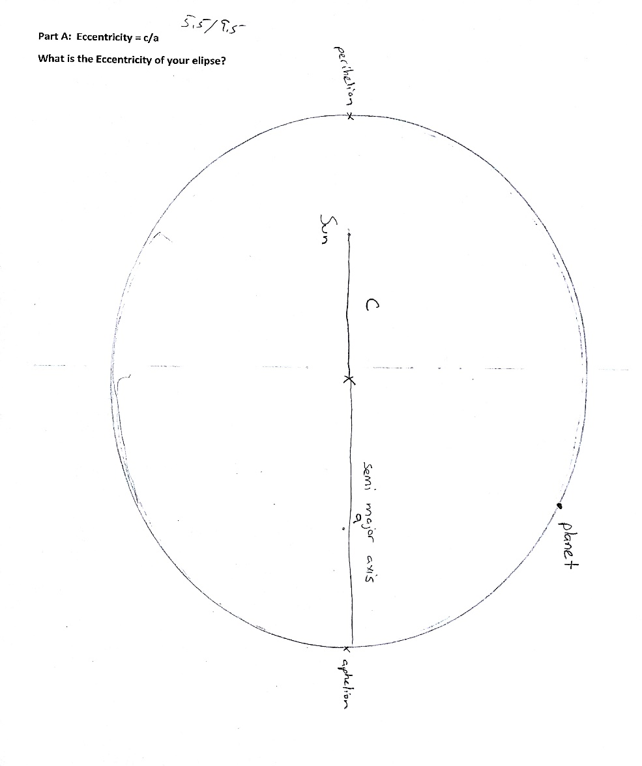
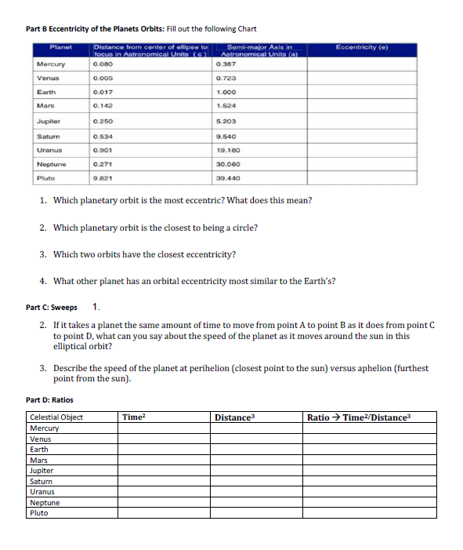
Turn this in to the basket near
If you were absent yesterday, please come ask me what this is

Slide 2
Retrograde Motion
When a planet appears to reverse its path in the sky because of the apparent angle of observation

Slide 3
https://www.youtube.com/watch?v=72FrZz_zJFU

Slide 4
Complex Knowledge: demonstrations of learning that go aboveand above and beyond what was explicitly taught.
Knowledge: meeting the learning goals and expectations.
Foundational knowledge: simpler procedures, isolated details, vocabulary.
Limited knowledge: know very little details but working toward a higher level.
Understand how our view of the solar system has changed over time and how discoveries made have led to our changing our view of the solar system.
Learn planetary characteristics such as number of moons, size, composition, type of atmosphere, gravity, temperature and surface features.
Understand the movement of planetary bodies.
Understand which planetary characteristics are more important than others when it relates to our understanding of other worlds.
Understand how proximity to the sun influences planets.
Understand the methods and tools scientists use to learn about other planets and moons in our solar system.
Understand the conditions needed for a habitable world and determine if there are habitable worlds in our solar system or outside the solar system.
Understand how we look for and study solar systems other than our own.

Slide 5
What have we looked at so far?
Planet Sizes
Planet distances

Slide 6
If some of you are having trouble on your planet data sheet – this might help
 | Mercury | Venus | Earth | Mars | Jupiter | Saturn | Uranus | Neptune
Rotation (Earth hours) | 1407 | 5832 | 24 | 24.6 | 9.9 | 10.7 | 17.2 | 16.1
Revolution (Earth years) | .24 | .61 | 1 | 1.88 | 11.9 | 29.44 | 83.8 | 163.8

Slide 7
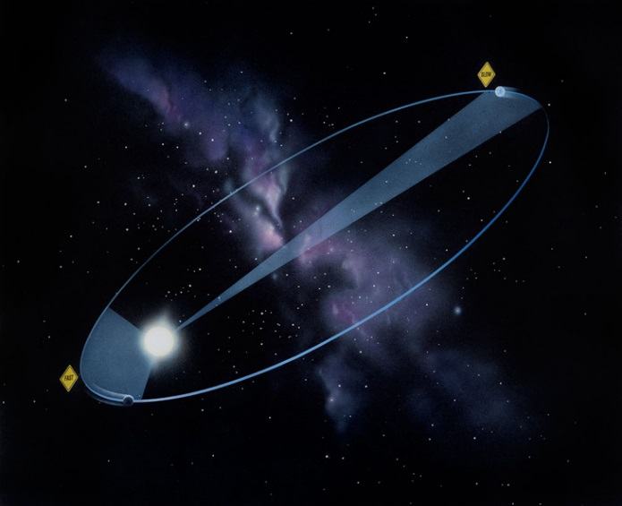
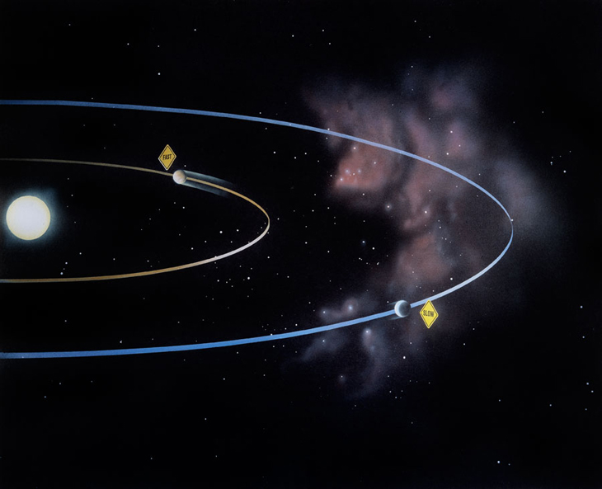
Keplers Laws
1
2
3

Slide 8
Kepler’s First Law: “The Law of Ellipses” The orbit of every planet is an ellipse with the Sun at one of the two foci.
“Part A” from yesterday’s activity

Slide 9
Kepler’s First Law describes the shape of an orbit. The orbit of a planet around the Sun (or a satellite around a planet) is not a perfect circle. It is an ellipse.

Slide 10
It is not just planets that have elliptical orbits
EVERYTHING ORBITING HAS ELIPTICAL ORBITS
Circular orbits are exceedingly rare in nature
Planets
The moon
Satellites

Slide 11
Both Earth and the Moon have elliptical orbits – Copernicus (heliocentric guy) didn’t know this

Slide 12
Eccentricity
How circular or elongated an ellipse is
Measured from 0-1
0 is a circle
1 is a line
“Part B” from yesterday’s activity

Slide 13
First Law – easy explanation
Everything Orbits in an Ellipse

Slide 14
Kepler’s Second Law: “The Law of Equal Areas” A line joining a planet and the Sun (radius) sweeps out equal areas during equal intervals of time.
“Part C” from yesterday’s activity

Slide 15
Kepler’s Second Law describes the way an object’s speed varies along its orbit. A planet’s orbital speed changes, depending on how far it is from the Sun. The closer a planet is to the Sun, the stronger the Sun’s gravitational pull on it, and the faster the planet moves. The farther it is from the Sun, the weaker the Sun’s gravitational pull, and the slower it moves in its orbit.

Slide 16
Second Law – easy explanation
A Planet (moon, satellite, etc.) moves faster the closer it is to the Sun, and slower the farther it is from the Sun.

Slide 17
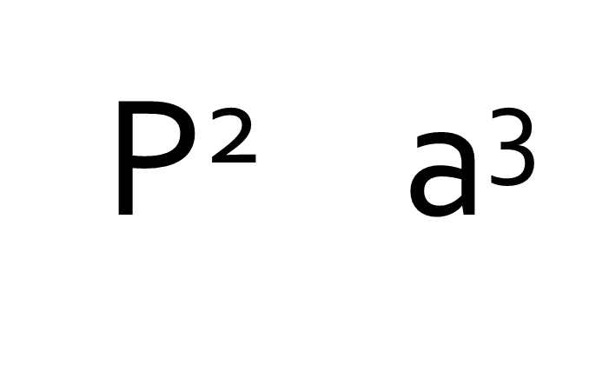
Kepler’s Third Law: “The Law of Harmonies” The square of the orbital period (1 revolution) of a planet is directly proportional to the cube of the semi-major axis (distance) of its orbit.
“Part D” from yesterday’s activity

Slide 18
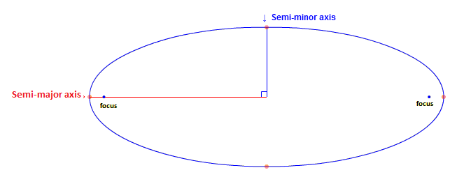
Semi Major Axis
(It’s another way to say “How far away the planet is from the Sun”)
It’s not the distance from the sun to the planet though

Slide 19
Kepler’s Third Law compares the motion of objects in orbits of different sizes. A planet farther from the Sun not only has a longer path than a closer planet, but it also travels slower, since the Sun’s gravitational pull on it is weaker. Therefore, the larger a planet’s orbit, the longer the planet takes to complete it.

Slide 20
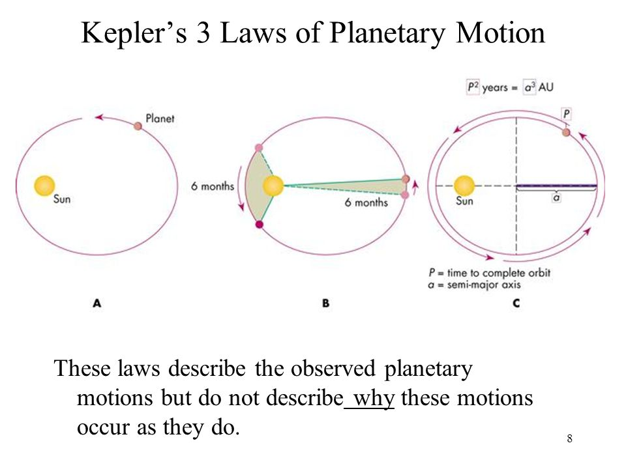

Slide 21
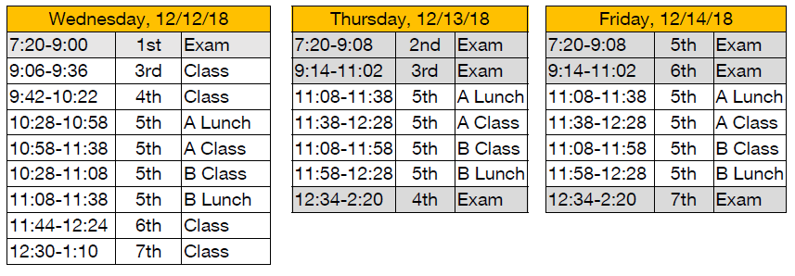
Monday 12/17
Project is Due
Song, PowerPoint, Skit, or Poster
Research Sheet for Planet is also due
Test Next Week ☺
12/20

Slide 22
Project: Turn in on Canvas
If you have a PowerPoint
Attach it to the assignment on Canvas
If you have a video or mp3 of a song/Skit
Attach it to the assignment on Canvas
If you are performing a song/skit after school
Let me know when
Turn in the lyrics/dialogue
If you have a poster board
Take a picture and attach it to the assignment on Canvas
You still must bring in the project and PUT A STICKY NOTE ON IT
You must turn your data packet in to the basket by the door on Monday

Slide 23
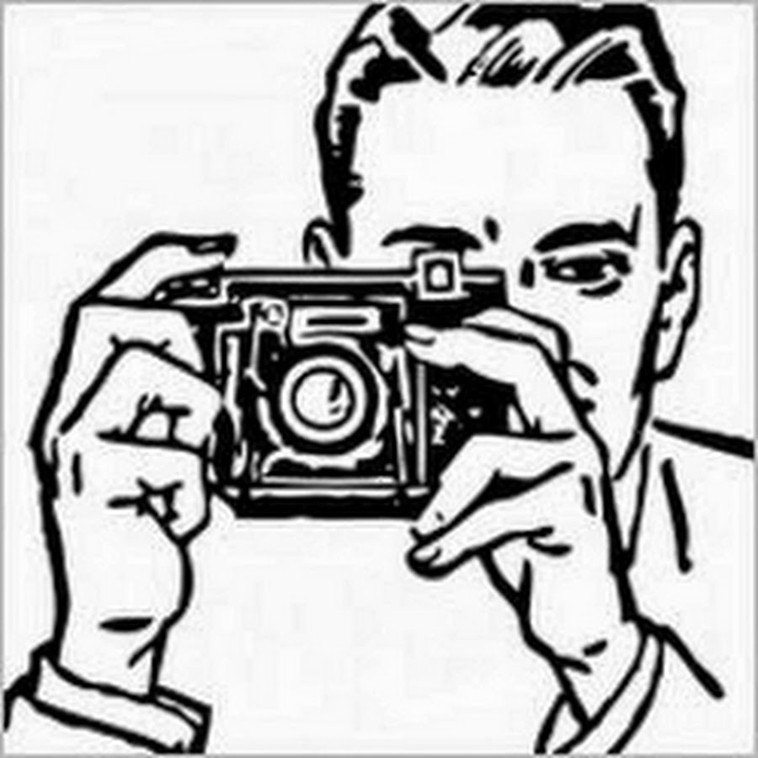
If you are turning in a physical project
IE. A Poster or a Diorama
YOU MUST PUT A STICKY NOTE WITH YOUR FULL NAME AND CLASS PERIOD ON IT!
Take a picture of your poster or diorama for google classroom
Your packet goes into the basket by the door

Slide 24
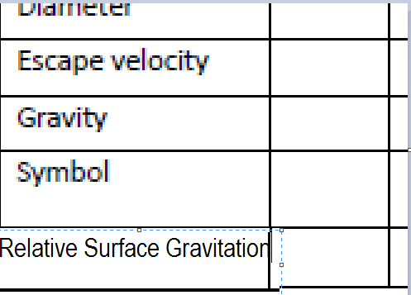
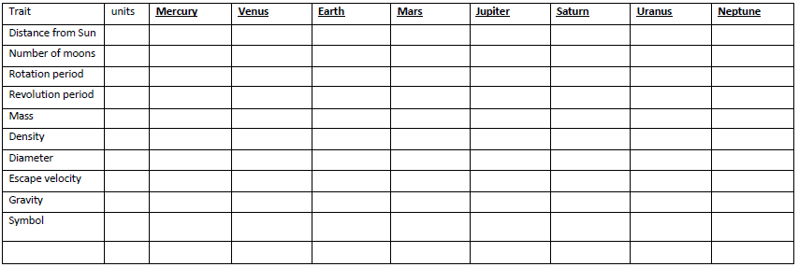
Add this on the bottom line

Slide 25
Mass and Gravity
 | Mercury | Venus | Earth | Mars | Jupiter | Saturn | Uranus | Neptune
Mass (10²⁴kg) | 0.330 | 4.87 | 5.97 | 0.642 | 1899 | 568 | 86.8 | 102
Gravity (m/s²) | 3.7 | 8.9 | 9.8 | 3.7 | 23.1 | 9.0 | 8.7 | 11.0
Relative Surface gravitation | 0.38 | 0.91 | 1.00 | 0.38 | 2.36 | 1.06 | .89 | 1.13
Copy the relative Surface gravitation down in the blank row
This is what you would multiply a weight by to determine what it would weigh on each planet.

Slide 26
Mass and Gravity
 | Mercury | Venus | Earth | Mars | Jupiter | Saturn | Uranus | Neptune
Mass (Earth Masses) | .0553 | .815 | 1 | .107 | 317.8 | 95.2 | 14.5 | 17.1
Gravity (m/s²) | 3.7 | 8.9 | 9.8 | 3.7 | 23.1 | 9.0 | 8.7 | 11.0
Relative Surface gravitation | 0.378 | 0.907 | 1.00 | 0.377 | 2.364 | 0.95 | 0.81 | 1.2
Copy the relative Surface gravitation down in the blank row
This is what you would multiply a weight by to determine what it would weigh on each planet.

Slide 27
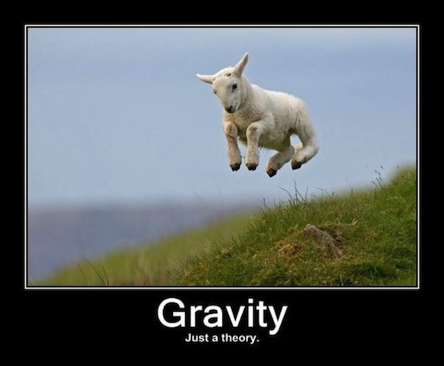
Gravity

Slide 28
What objects feel Gravitational Force? Write the numbers down in your journal
Ball thrown in the air
Rock falling off a cliff
Rock resting on the ground
Flying bird
Bird perched on branch
Astronaut on the moon
Astronaut in orbit
Star
Fish swimming in water
Person floating in water
Stone sinking in water
Speck of dust
Speeding car
Helium balloon
Object buried in ground
Photon of Light

Slide 29
Galileo
Dropping objects to Rolling objects
Start of experimental science
https://youtu.be/ZVfhztmK9zI

Slide 30
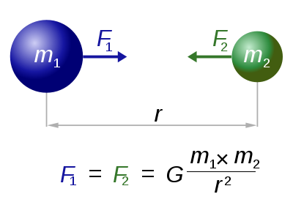
Gravity
d
Fg =F1 = F2 =gravitational force between the 2 objects
G = gravitational constant
M1 and M2 = masses of the 2 objects
d= distance between 2 objects
d

Slide 31
3 things to remember
There is a gravitational force between all objects
The larger the mass of the objects, the larger the gravitational force
Gravitational force decreases rapidly with increasing distance between the objects.

Slide 32
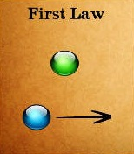
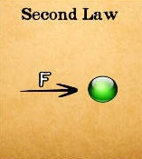
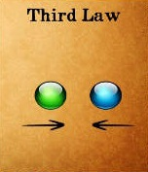
of Motion
Objects in motion stay in motion in a straight line, objects at rest stay at rest unless acted upon by an unbalanced force
F=mXa
Forces occur in pairs, equal in size, opposite in direction

Slide 34
Newton’s Cannon

Slide 35
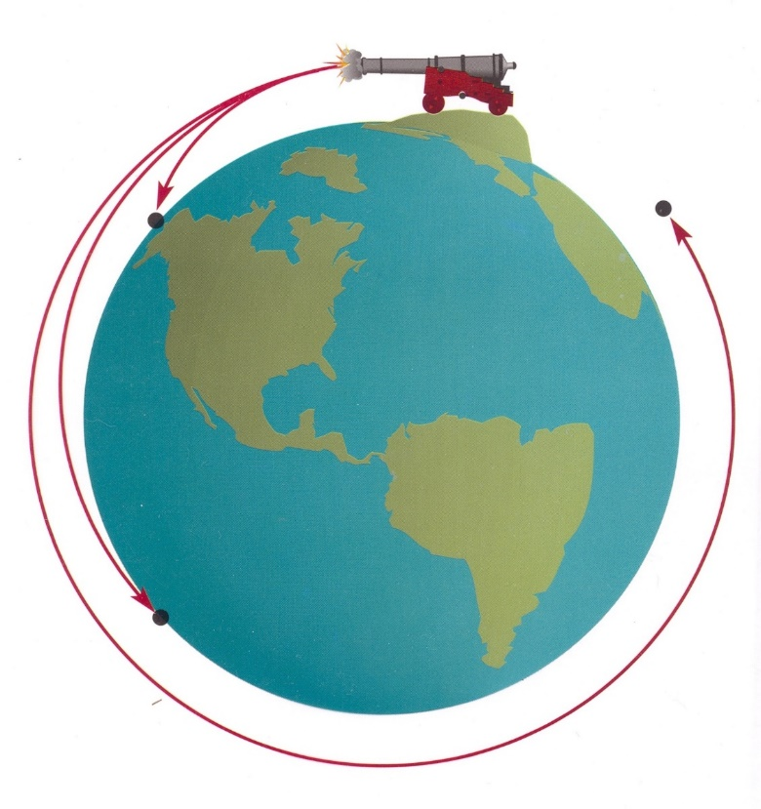
Things to ponder
The orbital speed on a tall mountain is about 6000 mph forward.
How does height above the ground affect the orbital speed?
What is the biggest difference between space and the ground? How does this affect orbits?

Slide 37
What is Gravity?
Write your answer to this question!

Slide 38
Mass and Gravity
 | Mercury | Venus | Earth | Mars | Jupiter | Saturn | Uranus | Neptune
Mass (10²⁴kg) | 0.330 | 4.87 | 5.97 | 0.642 | 1899 | 568 | 86.8 | 102
Gravity (m/s²) | 3.7 | 8.9 | 9.8 | 3.7 | 23.1 | 9.0 | 8.7 | 11.0
Relative Surface gravitation | 0.378 | 0.907 | 1.00 | 0.377 | 2.364 | 0.95 | 0.81 | 1.2
Copy the relative Surface gravitation down in the blank row
This is what you would multiply a weight by to determine what it would weigh on each planet.

Slide 39
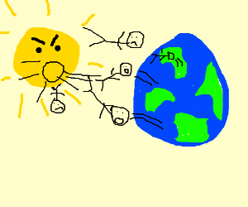
Why do we not fly off the surface of the Earth and into the Sun when the Sun has thousands of times more gravity?
Notes:
This bar timer, will start when anywhere on the slide is clicked. The bar will move from left to right and the word ‘End’ will appear at the end, accompanied by a ‘Deep Gong’ sound. It is possible to change the duration of this timer to any time, by entering the animation settings, and changing the timing for ‘rectangle 3’. Note the time has to be entered as a number of seconds – so if you want 2mins & 30secs – this is entered as 150 (60X2 + 30 = 150).

Slide 40
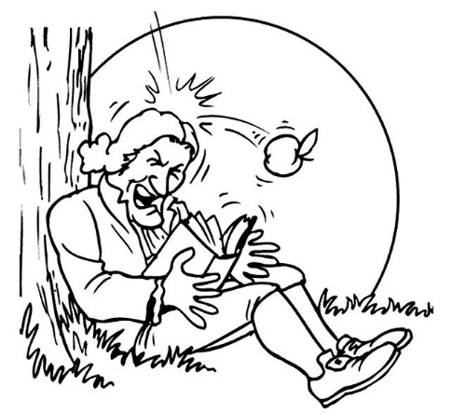
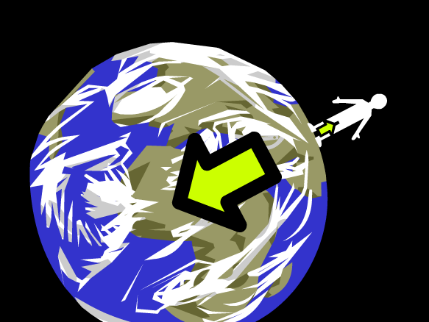
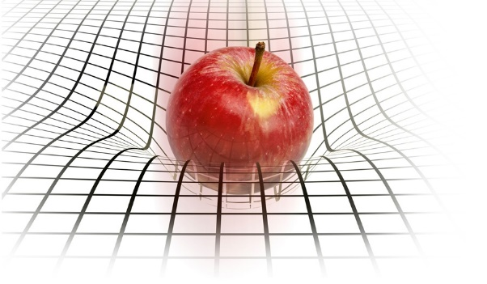
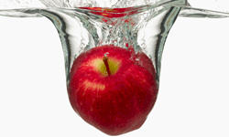
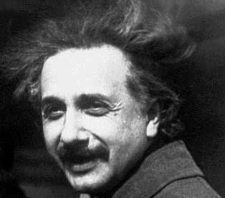
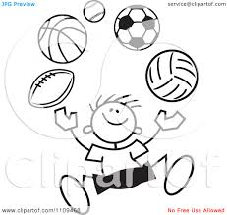
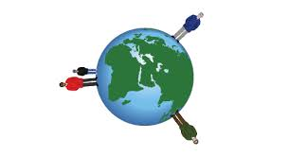
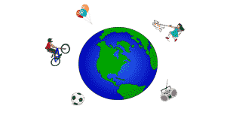
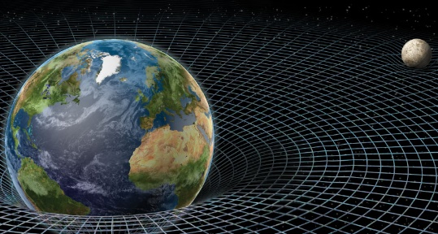
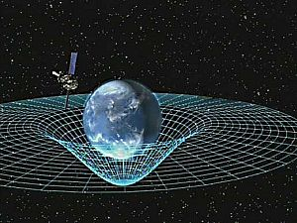
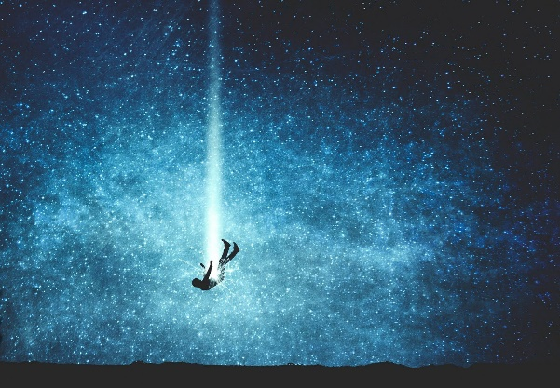
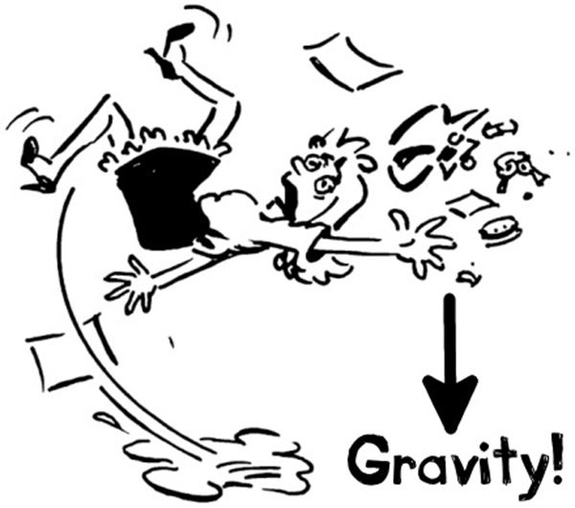
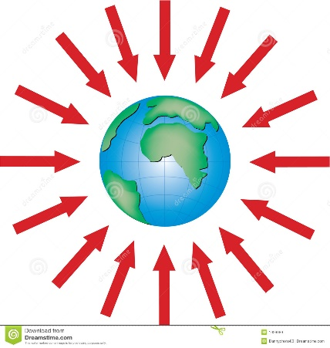
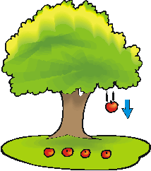
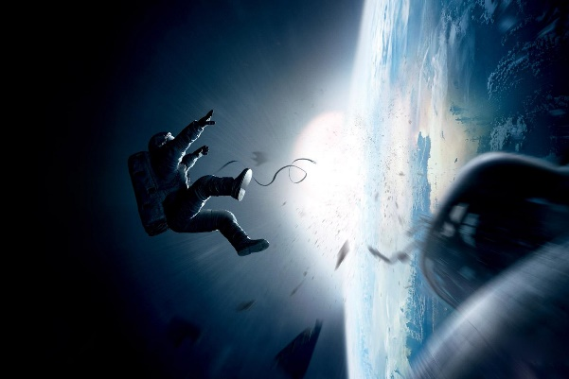
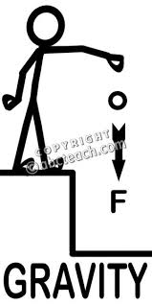
Summing it up – In your science Journal
GRAVITY ILLUSTRATION (picture)
3 visual representations of gravity in the same picture

Slide 41
Yesterday’s Question:
How can we determine the location and movement of planets in our solar system?

Slide 42
Classwork/Homework:
What does it mean to orbit?
Read 6 FYI articles (also on website)
Planetary Orbits
Orbiting
Orbits and Ellipses
Kepler’s Laws
Gravity
Gravitational Force
Answer questions on Canvas
Photo of your gravity pictures

