Slide 1
Send in your number
Complex Knowledge: demonstrations of learning that go aboveand above and beyond what was explicitly taught.
Knowledge: meeting the learning goals and expectations.
Foundational knowledge: simpler procedures, isolated details, vocabulary.
Limited knowledge: know very little details but working toward a higher level.
Understand how our view of the solar system has changed over time and how discoveries made have led to our changing our view of the solar system.
Learn planetary characteristics such as number of moons, size, composition, type of atmosphere, gravity, temperature and surface features.
Understand the movement of planetary bodies.
Understand which planetary characteristics are more important than others when it relates to our understanding of other worlds.
Understand how proximity to the sun influences planets.
Understand the methods and tools scientists use to learn about other planets and moons in our solar system.
Understand the conditions needed for a habitable world and determine if there are habitable worlds in our solar system or outside the solar system.
Understand how we look for and study solar systems other than our own.

Slide 2
Reminder
Your Project is due Monday, December 17th. → You have less than 2 weeks!

Slide 3
We are studying planets. Let get this out of the way.
https://youtu.be/SQTKGXmITZg

Slide 4
We are studying planets. Let get this out of the way.
https://www.youtube.com/watch?v=h3ppbbYXMxE

Slide 5
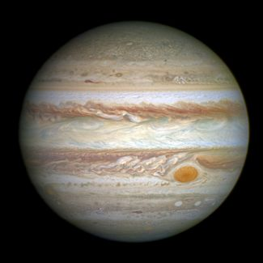
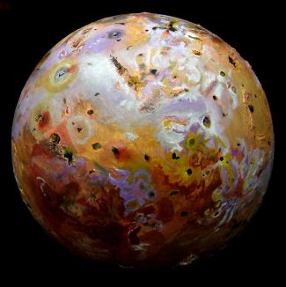
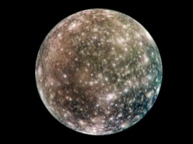
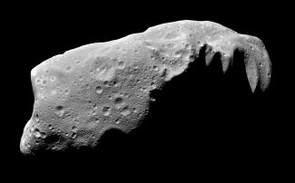
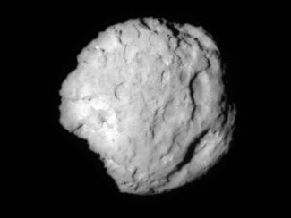
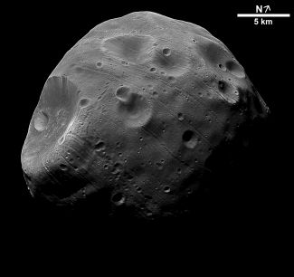
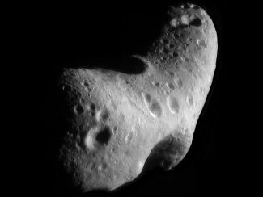
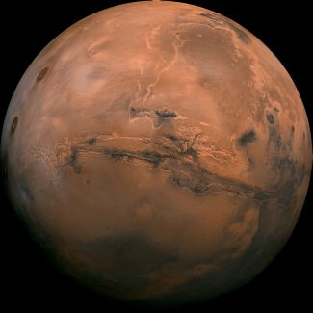
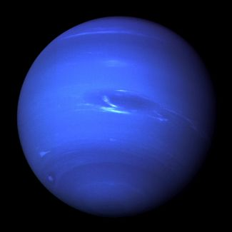
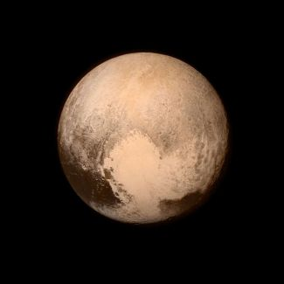
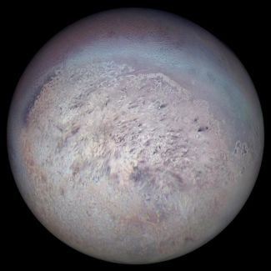
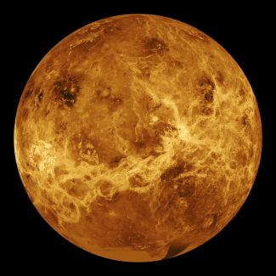
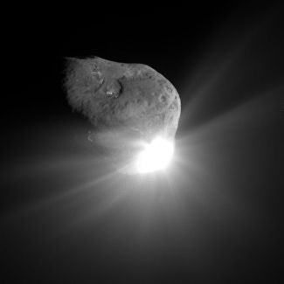
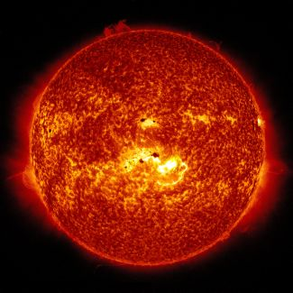
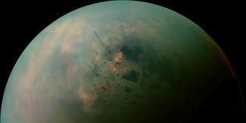
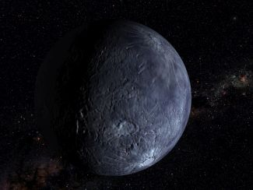
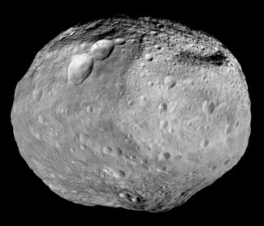
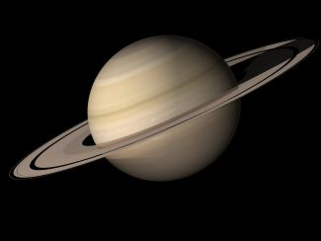
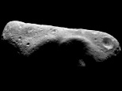
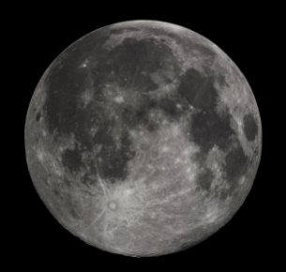
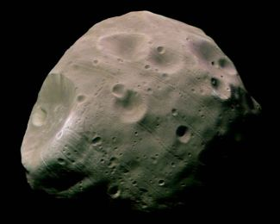
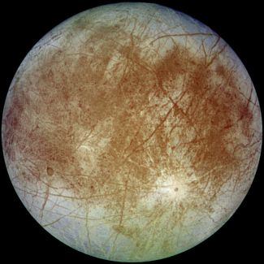
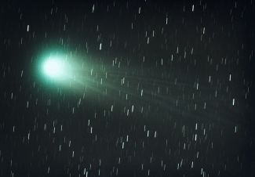
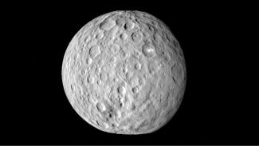
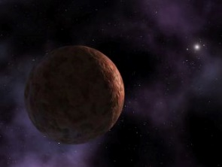
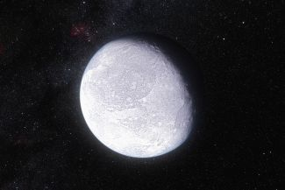
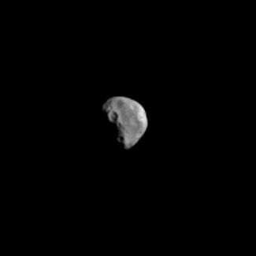
Did you need more than just pictures to correctly label things?

Slide 6
Size?

Slide 7
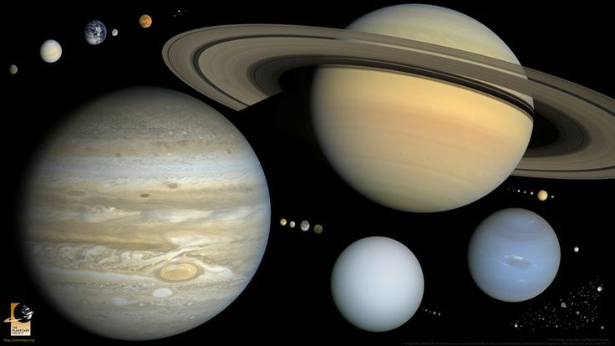
Everything in the solar system that is larger than 400 kilometers in diameter except the Sun. All the round moons, four asteroids, and more than 100 objects beyond Neptune. Photo by the Planetary Society

Slide 8
Shape?

Slide 9
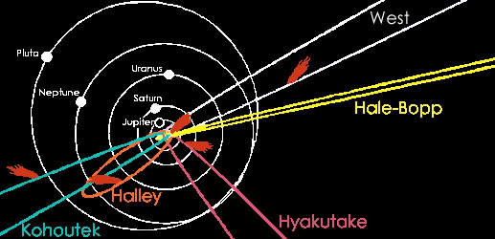
Distance?
Where do we stop?

Slide 10
Atmosphere?

Slide 11
Size of atmosphere?

Slide 12
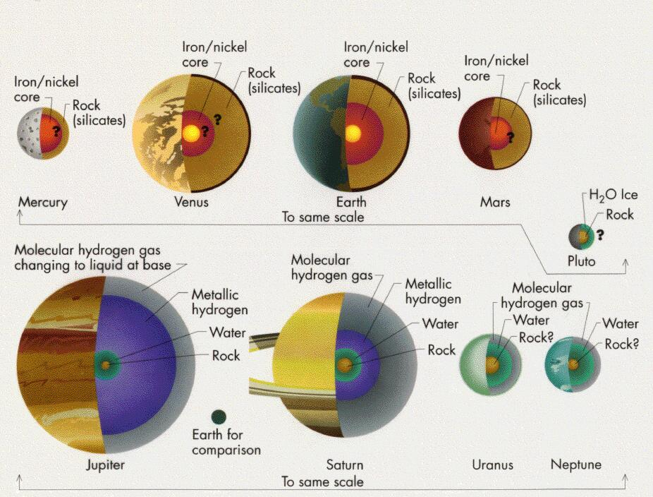
Composition?
What should it be made of?

Slide 13
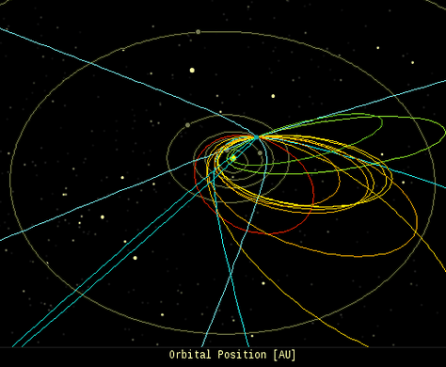
Orbit?
What does it orbit?

Slide 14
Back in the day…
If you were a student in astronomy class in 1850 how many planets would your teacher have taught you about?

Slide 15
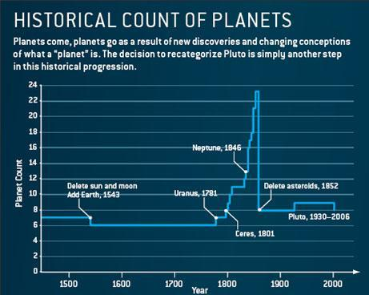
Planets throughout History
Pre 1543- 7 planets
1543- 6 planets
1781- 7 planets
1781-1851 –
up to 23 planets!
1852- 8 planets
1930 – 9 planets
2006 – 8 planets

Slide 19
The definition of planet set in Prague in 2006 by the International Astronomical Union (IAU) states that, in the Solar System, a Planet is a celestial body that:
is in orbit around the sun (is not a satellite/moon)
has sufficient mass (and therefore gravity) to assume a nearly round shape
has cleared the neighborhood around its orbit (gravitationally dominant)

Slide 20
What makes a dwarf planet:
is in orbit around a star but is not itself a satellite
is in orbit around the sun (is not a satellite/moon)
has sufficient mass (and therefore gravity) to assume a nearly round shape
has NOT cleared the neighborhood around its orbit (gravitationally dominant)
The IAU further resolves:
Pluto is a "dwarf planet" by the above definition and is recognized as the prototype of a new category of Trans-Neptunian Objects

Slide 21
:
Planet:
is in orbit around the Sun,
has sufficient mass to assume hydrostatic equilibrium (a nearly round shape), and
has "cleared the neighborhood" around its orbit.
Dwarf Planet
is in orbit around the Sun,
has sufficient mass to assume hydrostatic equilibrium (a nearly round shape), and
has "cleared the neighborhood" around its orbit.
Small Solar System Body (SSSB)
is in orbit around the Sun (not a moon of another object)
has sufficient mass to assume hydrostatic equilibrium (a nearly round shape), and
has "cleared the neighborhood" around its orbit.

Slide 22
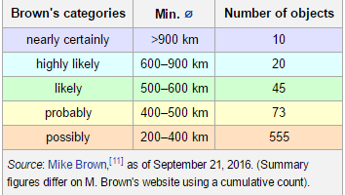
Why have people been talking about Pluto?
Initial drafts planned to include dwarf planets as a subcategory of planets, but because this could potentially have led to the addition of several dozens of planets into the Solar System, this draft was eventually dropped. The definition was a controversial one and has drawn both support and criticism from different astronomers, but has remained in use.

Slide 23
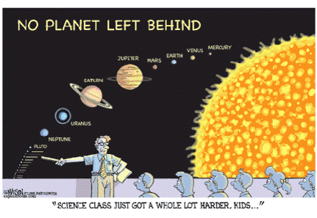

Slide 24
Owen Gingerich, Harvard science historian, Gareth Williams, associate director of the IAU's Minor Planet Center, and Dimitar Sasselov, director of the Harvard Origins of Life Initiative, took part in a debate on place Sept. 18 with scientists, teachers and civilians watching. The two from Harvard, Gingerich and Sasselov, said Pluto should be a planet. A vote among audience members agreed.

Slide 25
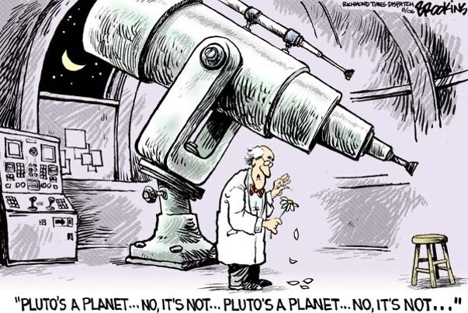

Slide 26
What’s next for Pluto? Not much, officially, according to a spokesman from the International Astronomical Union: "There are currently no requests from any astronomers to put this issue on the agenda at the General Assembly" of the IAU, wrote Lars Lindberg Christensen, IAU press officer.
The last IAU General Assembly was in Honolulu in August 2015. The next is in August 2018

Slide 27
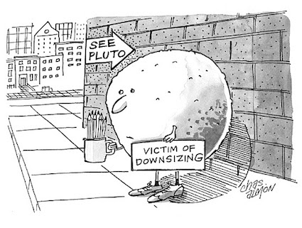

Slide 28
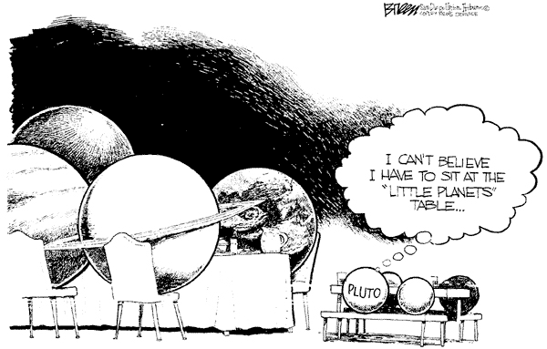

Slide 29
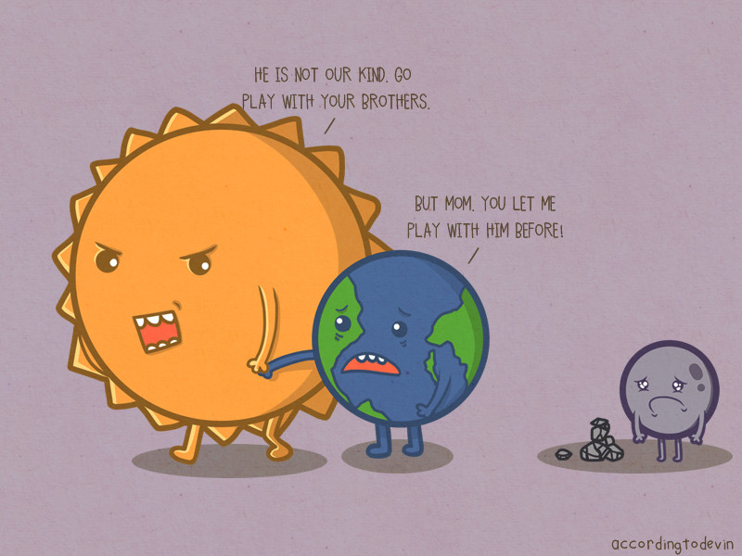

Slide 30
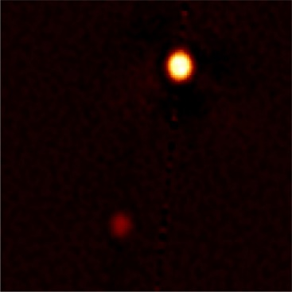
What does Pluto look like?
http://www.gemini.edu/node/11893
Sharpest Ever Ground Based Images of Pluto

Slide 31
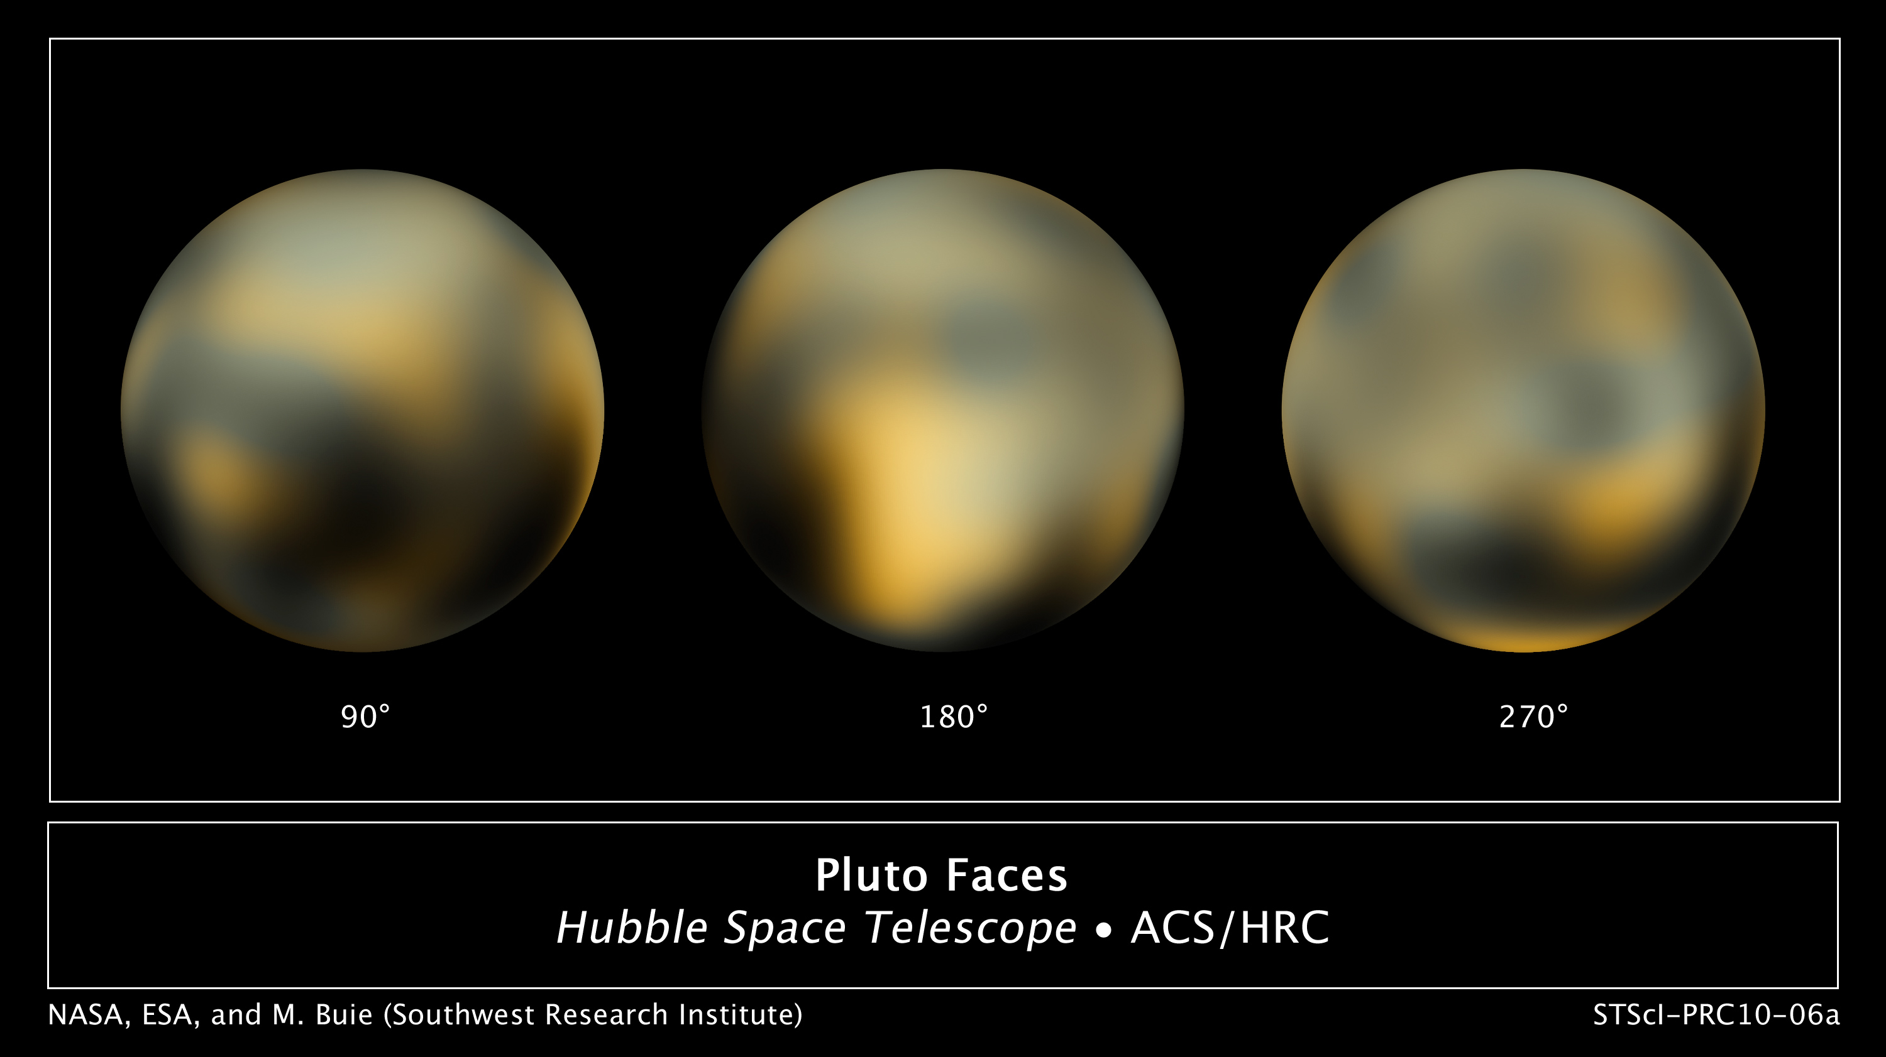
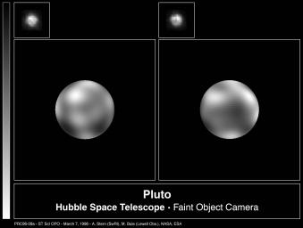
Hubble Images of Pluto

Slide 32
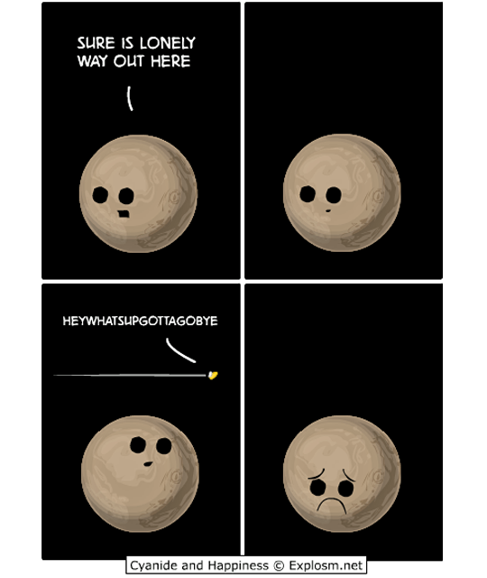

Slide 33
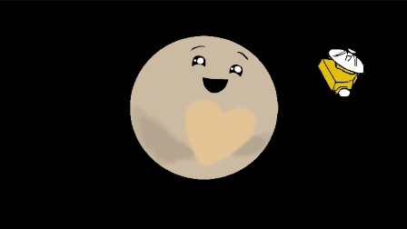
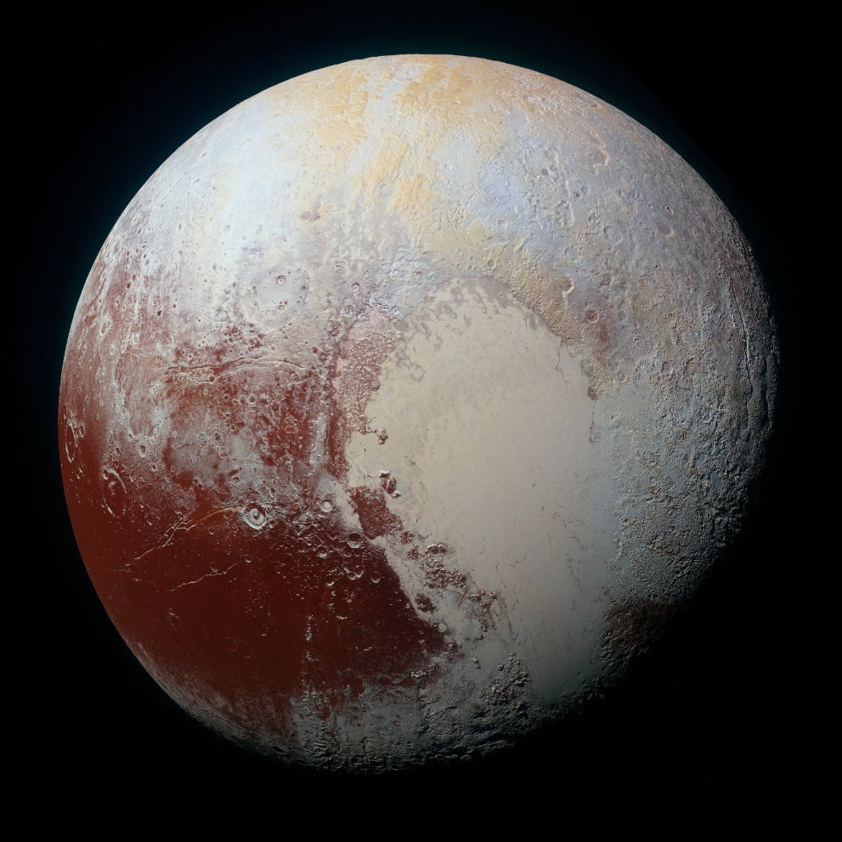
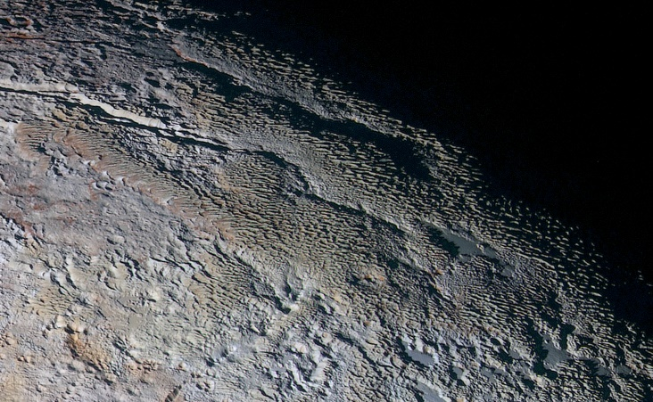
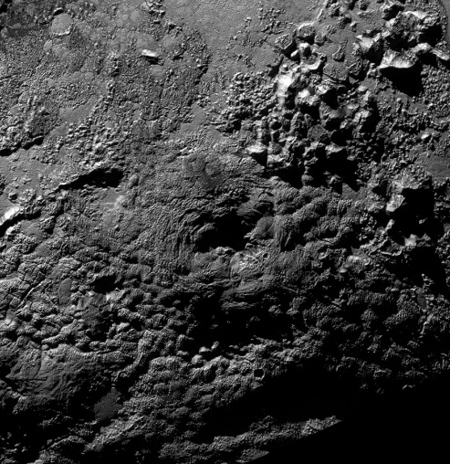
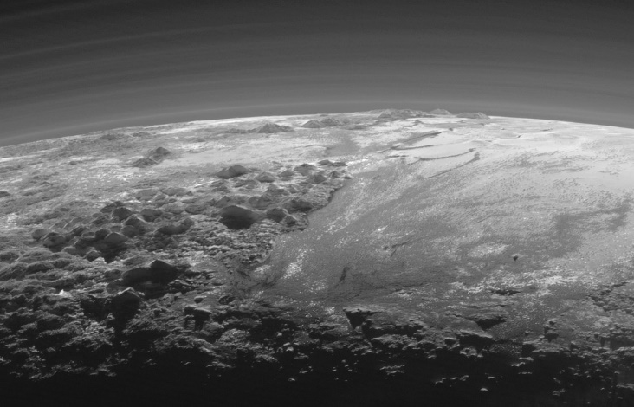
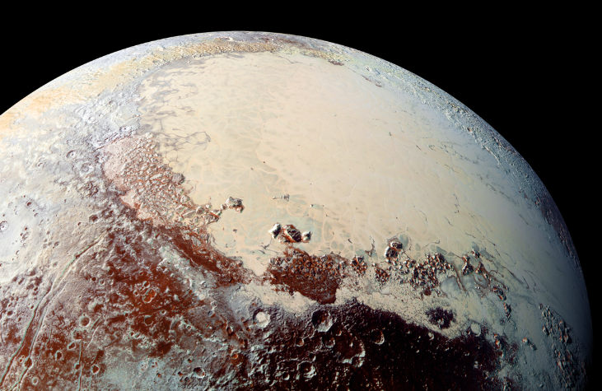
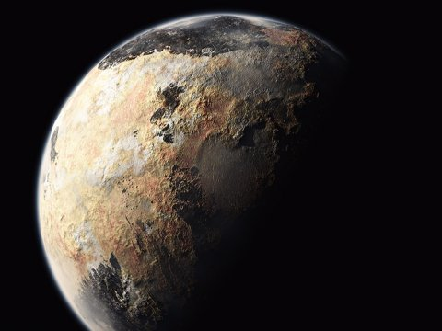
New Horizons!!!!

Slide 35
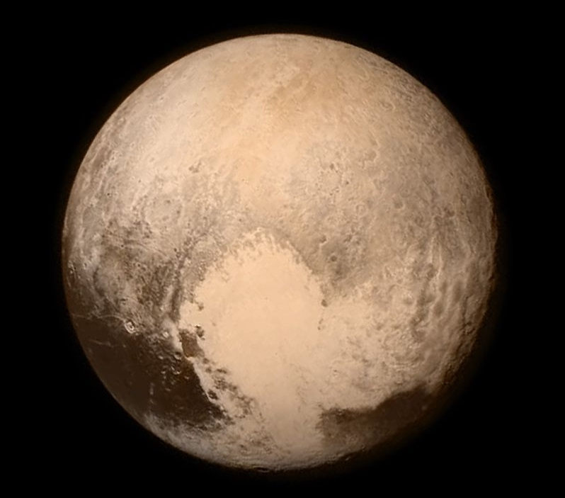
You cannot un-see what I’m about to show you.

Slide 37
Eris

Slide 40
Ceres: The largest Asteroid

Slide 48
So what’s a planet?!?!?
http://florida.pbslearningmedia.org/resource/hew06.sci.ess.eiu.planetdefine/what-is-a-planet/

Slide 49
Homework: Read

Slide 50
Respond: By tomorrow

Slide 51
Due Tomorrow

Slide 52
An Awesome Song!!
https://youtu.be/4tw_RiQp6H8

