Slide 1
Complex Knowledge: demonstrations of learning that go above and above and beyond what was explicitly taught.
Knowledge: meeting the learning goals and expectations.
Foundational knowledge: simpler procedures, isolated details, vocabulary.
Limited knowledge: know very little details but working toward a higher level.
Understand how our view of the solar system has changed over time and how discoveries made have led to our changing our view of the solar system.
Learn planetary characteristics such as number of moons, size, composition, type of atmosphere, gravity, temperature and surface features.
Understand the movement of planetary bodies.
Understand which planetary characteristics are more important than others when it relates to our understanding of other worlds.
Understand how proximity to the sun influences planets.
Understand the methods and tools scientists use to learn about other planets and moons in our solar system.
Understand the conditions needed for a habitable world and determine if there are habitable worlds in our solar system or outside the solar system.
Understand how we look for and study solar systems other than our own.

Slide 2
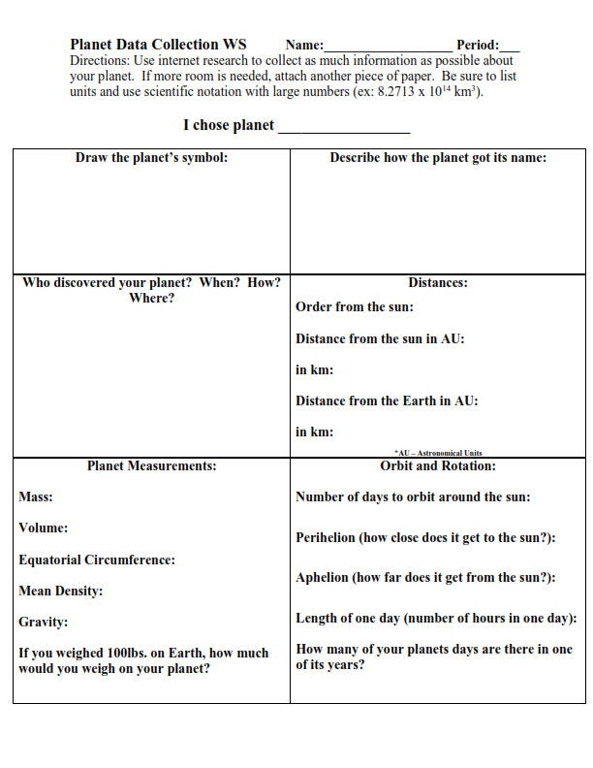
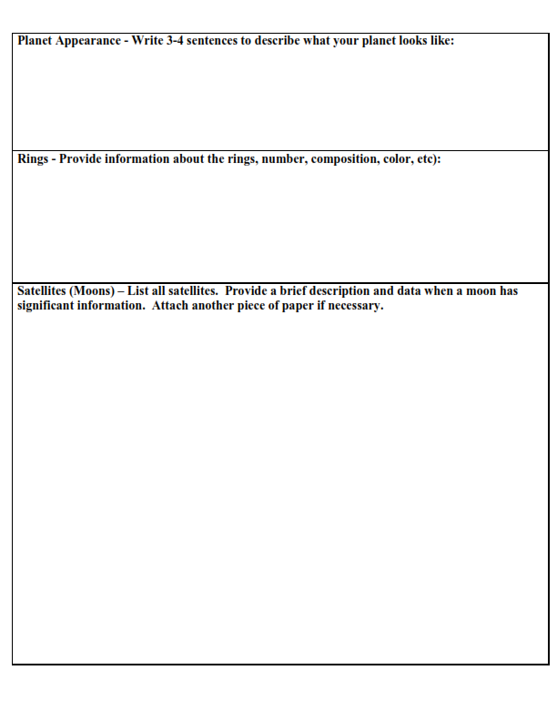
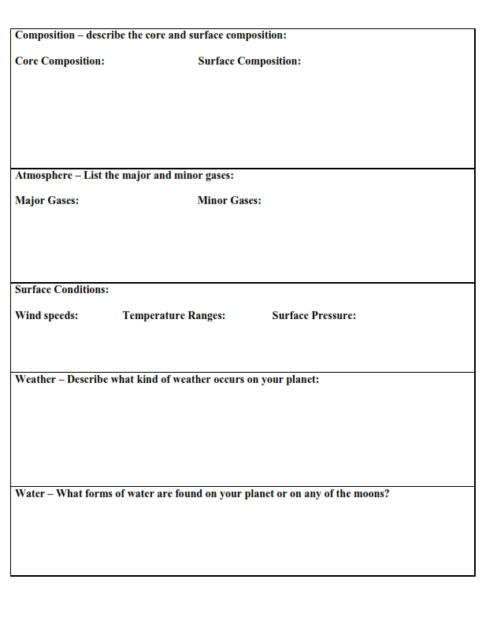
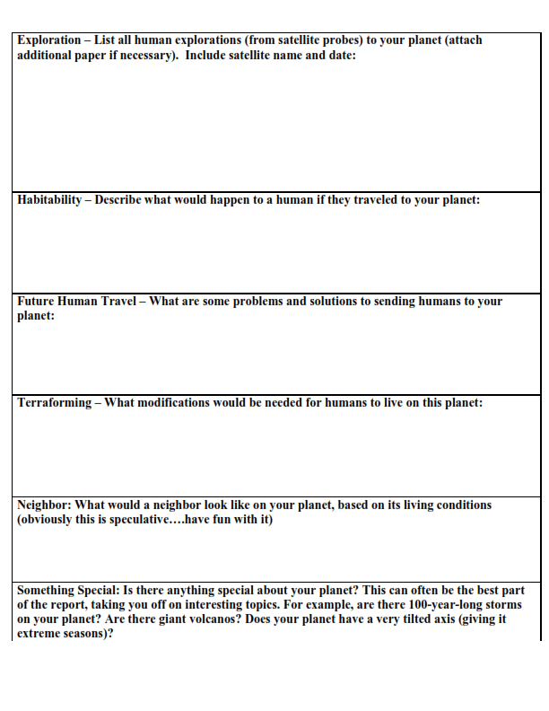
Due Friday December 17th
This is on my desk (and mrhyatt.rocks) – and it’s worth 50 points if it is completely filled in

Slide 3
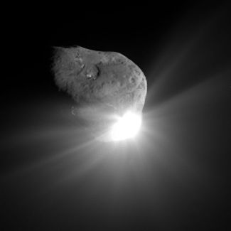
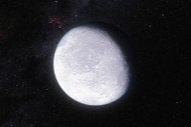
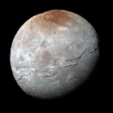
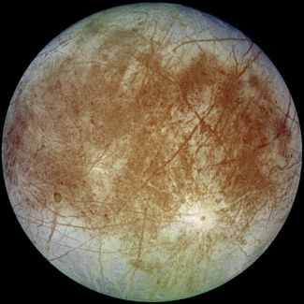
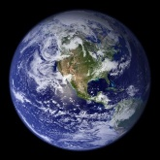
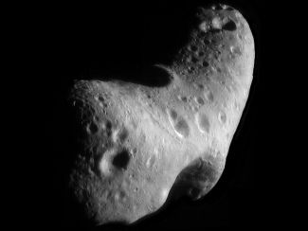
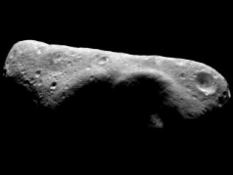
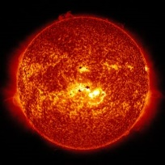
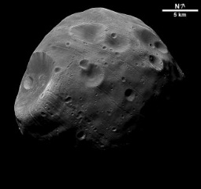
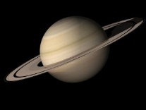
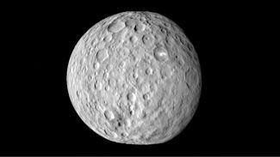
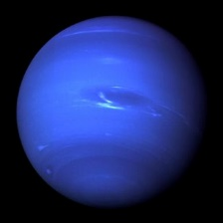
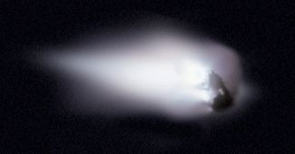
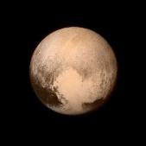
You could use more or less than 4 (at least 3)
Name of category
Criteria to join group
Name of category
Criteria to join group
Name of category
Criteria to join group
Name of category
Criteria to join group

Slide 4
Web Quest
WebQuest.org defines a WebQuest as "... an inquiry-oriented lesson format in which most or all the information that learners work with comes from the web.“

Slide 5
